Slide 1
A data warehouse now, using methods of the future
Enterprise Data World 2016
SanDiego, Ca – April 17-22, 2016
Luminita Vollmer
luminita.vollmer@gmail.com
Notes:
Disclaimer – don’t endorse any products or vendors

Slide 2
agenda
Intro
It’s 2016 – what’s new!
Use cases for data
Everyday pressures and big data
Traditional dw and how it extends
Components
Hadoop

Slide 3
Speaker Bio
IT professional for over 20 years
Data Architecture /Enterprise Information
Undergraduate studies in MIS/Business
MBA – College of St. Thomas in St. Paul, MN
CDMP, CBIP certified
Cyber Fraud Analyst / AML in training
Digital Strategy and Advanced Analytics hopeful

Slide 4
What Makes Thrivent Financial Unique?
Notes:
Ask …
How many of you are familiar with Thrivent?
How many of you are members?
Those of you who are familiar with Thrivent likely know this, but Thrivent is a unique organization. We are proud of who we are and what we do.
We like to describe ourselves using this picture equation:
Cross: We’re a not-for-profit membership organization of Christians. And our members – who we call member-owners – collectively own the organization, not shareholders.
$: We help members be wise with money by offering guidance and competitive financial products and services.
Heart: Our mission is very different from most financial services organizations. We’re here to help our members be wise with money AND live generously. We believe those two things go hand in hand.
Smiling faces: And together, all these factors make communities stronger.
This blending of faith, finances and generosity sets us apart from others.

Slide 5
About Thrivent Financial
We are:
100+ years old.
Membership-owned (more than 2.3 million members).
#333 on Fortune 500 (June 2015).
We have:
$109.2 billion in assets under management/advisement (Dec. 31, 2015).
$8.3 billion in total adjusted surplus (Dec. 31, 2015).
9.3 million hours volunteered in 2015 (Dec. 31, 2015).
$203.9 million raised and donated in 2015 to help others (Dec. 31, 2015).
We’ve earned:
A.M. Best—A++ (Superior) Highest of 16 ratings (June 2015).*
Fitch Ratings—AA (Very Strong) 3rd highest of 19 ratings (Sept. 2015).*
Consecutive awards as one of the “World’s Most Ethical Companies” by Ethisphere Institute.
*Ratings reflect Thrivent’s overall financial strength and claims-paying ability. They do not apply to the performance of Thrivent’s investment products.
Notes:
Here’s some more information about who we are:
Thrivent has been around for more than 100 years, and we have more than 2.3 million members. We rank #333 on the Fortune 500.
Our assets under management/advisement and surplus indicate our size and financial strength. And our outreach makes a difference around the world.
So what do others say about us?
Independent insurance analysts A.M. Best and Fitch Ratings give Thrivent high marks for financial strength and claims-paying ability—two attributes that count when you’re purchasing a future promise to pay, which is what insurance is. (Ratings reflect Thrivent Financial’s overall financial strength and claims-paying ability, but do not apply to the performance of investment products.)
And, the Ethisphere Institute named Thrivent as one of the “World’s Most Ethical Companies” in 2012 , 2013, 2014, 2015 and 2016.

Slide 6
It’s 2016!
Last year - Millennials and Gen X surpassed the number of Baby Boomers. Technology, social media, and the Internet of Things are transforming our lives at an unprecedented rate.
Strategy Analytics released a report last month that predicted M2M connections will grow from 368 million this year to 2.9 billion by 2022.
Data management domain – relational database is no longer the only database of choice. The vendors are many more and different; the designers require new skills and the expectations are let’s say more predictive.
User and Analytic Sandboxes, Virtual integration, Advanced Analytics - only a handful of the components that require a new architecture to meet business requirements. This session provides a framework for the architecture of the big data warehouse, the components and the new technology needed
The attendees will get a good understanding of the following:
Changes in the architectural components of the big data warehouse
Benefits and capabilities of the new technologies
Specific technologies and implementation alternatives
Top 10 important concepts about the new architecture
Notes:
Intro myself and the abstract Disclaimer for Thrivent
Disclaimer for vendor and products
Tell a couple of jokes
There are 10 kinds of people in the world – those that understand binary and those that don’t
Take a poll – 1. Business vs IT
2. Archs vs non archs
Abstract of the presentation. Major socio demographic events.
Major technological events
The point where data is everywhere and

Slide 7
It’s 2016!
Last year - Millennials and Gen X surpassed the number of Baby Boomers. Technology, social media, and the Internet of Things are transforming our lives at an unprecedented rate.
Strategy Analytics released a report last month that predicted M2M connections will grow from 368 million this year to 2.9 billion by 2022.
Data management domain – relational database is no longer the only database of choice. The vendors are many more and different; the designers require new skills and the expectations are let’s say more predictive.
User and Analytic Sandboxes, Virtual integration, Advanced Analytics - only a handful of the components that require a new architecture to meet business requirements. This session provides a framework for the architecture of the big data warehouse, the components and the new technology needed
The attendees will get a good understanding of the following:
Potential architectural components of the big data warehouse
Benefits and capabilities of the new technologies
Specific technologies and implementation alternatives
Top 10 important concepts about the new architecture
NoSQL
data scientist
machine learning
search
d3, R, visualization
Hadoop
open source
What now?
Notes:
Intro myself and the abstract Disclaimer for Thrivent
Disclaimer for vendor and products
Tell a couple of jokes
There are 10 kinds of people in the world – those that understand binary and those that don’t
Take a poll – 1. Business vs IT
2. Archs vs non archs
Abstract of the presentation. Major socio demographic events.
Major technological events
The point where data is everywhere and

Slide 8
the internet in 2016
The Internet of Data
The Internet of Things
The Internet of Ideas
The Internet of People
Notes:
It is 2016. We’ve worked with the traditional data warehouse for a long time now, only structured data is a thing of the past.
The dimensions that we function in are all connected by data and the internet.
The means to connect are changing as well, our habits, our skills, our approaches to solutions – starting to change
WE – the people that invented the datawarehouse – are being replaced by people that are using the data lake
The technology we have been using is changing
The way we look at things is different, the ideas that are born are new and different – who thought of a 32D printer?
Of limbs for dogs, kids and adults even, made of rubber printed on a printer.
Of cameras that see through galaxies, satelites that reflect 4 times the creation of a super nova?

Slide 9
Market Pressures
Data exhibiting different characteristics – 3 V’s
Internet of Things
Time series analysis
Log files analysis
Enterprise Security
Highly regulated systems (Healthcare, Government)
Streaming
Keep Operational Cost Low
High-availability
Speed of change across several dimensions – technology, data sources, competition, markets

Slide 10
big data
1- big data is data large enough to obscure their underlying meaning
2 - data sets for which traditional methods of storing, accessing, and analyzing are breaking down
usually we bring out the 3V’s :
volume velocity variety
data tagged as big data if it satisfies any of the two above stated characteristics and traditional technologies fail to adequately process it.
Notes:
Not a definitional introductory session
Volume: Refers to the fact that big data involves analyzing comparatively huge amounts of information, typically starting at tens of terabytes.
Velocity: Reflects the sheer speed at which this data is generated and changes. For example, RFID tags and smart metering are driving an increasing need to deal with torrents of data in near-real time.
Variety: Data today comes in many formats – from traditional databases to hierarchical data stores created by end users and transactional systems, to text documents, email, meter-collected data, video, audio, stock ticker data and financial transactions.
Big data scares us
Technology makes us panic – there are hundred of thousand of vendors, of software packages and we have a hard time making sense of it all
How do we make the decision? What is the best approach?

Slide 11
big data is also
new technologies, both infrastructure and software
new workloads
new people skills
new approach ( commodity vs. enterprise grade ; sandbox vs integrated data)
Notes:
What does this mean for us then?
Scaleout vs scale up
Infra fit for a particular workload
People skills are more versatile
Approach is more nimble, one person does it all
Sys admin as well as code
Data scientis data engineer

Slide 12
three eras of enterprise data
Siloed Systems
ERP Drives BI/DW
NoSQL and Documents
ERP
ERP
Documents
Documents
OLTP
HR
Finance
Inventory
Sales
BI/Data Warehouse
BI/Data Warehouse
NoSQL
OLAP
1970s, 80s, 90s
1990s, 2000s
Today
Notes:
NoSQL will NOT replace ERP or BI/DW systems –it will complement them and also facilitate the integration of unstructured document data with search facilities
The new technology is the answer to a different set of problems
The reports and the BI will still be there
Only now we have additional problems to solve and there are different solutions to those problems

Slide 13
Scale Up vs. Scale Out
Scale Up
Scale Out
Make a single CPU as fast as possible
Increase clock speed
Add RAM
Make disk I/O go faster
Make Many CPUs work together
Learn how to divide your problems into independent threads

Slide 14
traditional data warehouse
Enterprise Data Warehouse
Notes:
In the past – IT people cleverly designed data warehosues using rdbms technology and kimball inmon menthodology
The scaling was up – integration was complex and more complex
Oracle 2001 gives us this picture – and if you search – there are many many more just like this. Simple but did the job very well until 2008
What happened in 2008?

Slide 15
traditional data warehouse
Acquire Integrate Store Publish/Present
Enterprise Data Warehouse
centered around a single instance database, data marts, ODS
Notes:
With EIM – Enterprise Information Management on top / high level capabilities
Regardless is traditional or extended – you have the same capabilities at the top
How you provide solutions is different
Accept the fact that there are many changing things
What happened in 2008? – salesforce happened, Amazon AWS
In 2008 the world economy faced its most dangerous crisis since the Great Depression of the 1930s. T
he contagion, which began in 2007 when sky-high home prices in the United States finally turned decisively
downward, spread quickly, first to the entire U.S. financial sector and then to financial markets overseas.
The casualties in the United States included a) the entire investment banking industry, b) the biggest insurance company,
c) the two enterprises chartered by the government to facilitate mortgage lending,
d) the largest mortgage lender, e) the largest savings and loan, and f) two of the largest commercial banks.

Slide 16
data sources for the data warehouse
variety leads to hybrids
Notes:
Components – many more sources, with a hose velocity
How do we describe a braille data source? Or a report?

Slide 17
extended data warehouse
Gartner – describes the evolution to the Logical DW
TDWI – Environment
Luminita – DW is becoming extended
additional workloads for new data types
it includes NoSQL dbases
it includes a variety of analytical tools
the vendors are in large numbers, fit for specific needs and use cases
Notes:
In the past – IT people cleverly designed data warehosues using rdbms technology and kimball inmon menthodology
The scaling was up – integration was complex and more complex
Traditional is becoming extended – new workloads
New tools
New storage structures
New databases
New ways of investigating the data
New visualization – we are good at grasping large amounts of data by looking at a picture

Slide 18
big data types
The format of the content
The type of data (transaction data, historical data, or master data, for example)
The frequency at which the data will be made available
The intent: how the data needs to be processed (ad-hoc query on the data, for example)
Whether the processing must take place in real time, near real time, or in batch mode.

Slide 19
the components
data standards
logical design
physical plan
capabilities plan
people and processes to fit the changes
technology appropriate for the job
Changes in the way we work
Business
IT
Notes:
In the past – the answers came from the traditional data warehouse
The components – data sources ETL data structures for DW data structures for Dmarts and then BI
Standards and governance
Conceptual and logical designs give us correct placement of the business concepts into the applications
Now – we continue having the traditional data warehosue and add new components
Every presentation has a Venn diagram – IT and Business have to work together.
What are the class words for big data? Document? Stream? Video? Based on content?
Somehow we need protocols to identify the resources as what they are

Slide 20
It started with Hadoop
Hadoop is a distributed file management and analysis approach where data is split into equal sized flat file and stored in distributed platform and processed.
It does not support updates or changes into the existing record which is an important process in a data warehouse system.
Hadoop cannot be a replacement to a traditional data warehouse.
Therefore, big data can be implemented as an extension of a traditional Data Warehouse to support real time and unstructured data management and analysis.
Several Business Intelligence (BI) and DW technology vendors have tried to integrate Hadoop technology with their DW technology to make a seamless analysis of structured and unstructured data stored on two different environments from single user interface and produce integrated business analytics results.
Notes:
It’s a workload difference
Approach – schema on read vs on write
Complementary
A cluster – group of computers interconnected known as nodes

Slide 21
shared nothing architecture
Notes:
Concepts that come with hadoop that we didn’t have before

Slide 22
benefits and capabilities of the new environment
hadoop ecosystem
analytics is custom code (MapReduce, Pig, R, Python, Scala)
machine learning projects (Mahout) and libraries (Spark Machine Learning Library [MLlib])
search (Lucene and Solr)
other myriad of third-party tools

Slide 23
benefits and capabilities of the new environment
New workloads
ingestion of brokered data
data provenance in presentation
truly distributed systems – Ryak and Basho
very-very large system using Mongodb – eBay, amazon,
Real time data mixed with hadoop distributed data and ML techniques give us fraud detection

Slide 24
traditional data warehouse is changing
logical models – data concepts and relationships
standards
semantics and ontologies
physical models – describe the deployment
the data structures
server topology ( recent years it was the focus of architecture)
integration – most complex domain
governance – standards for interaction
data quality
Notes:
In the past – the answers came from the traditional data warehouse

Slide 25
Hadoop tiered architecture
Analytics
data science ] app dev ] ad hoc
Hadoop
integration and metadata
Analytics
Hadoop
other data sources
Single tier
architecture
Extended data warehouse architecture
Notes:
2 reasons for hadoop
Bridge information silos by moving the data from the silos in Hadoop
Get to the data faster by landing data in its native or near-native format in Hadoop, taking advantage of schema-on-read
We start with a single tier architecture – and progress to an extended dw architecture
Hortoworks calls it hybrid datawarehouse

Slide 26
changes
largest taxi company has no taxis-uber
largest hotel company has no hotels – airbnb
Largest retailer has no inventory - amazon
open source / adaptive sourcing
ecosystems for extra large ( 10 billions of ) something
break stuff and move fast ( facebook?)
fearless
we don’t walk we are running
Notes:
Young people are fearless
MOOC classes offer an eye opening experience – I’m taking a class right now from MIT – people from 182 countries participate ( U.lab )
Video classes, hub groups of people sharing experiences of changing the world, companies and selves
Open source is one way to change –
Carnegie Mellon has lots of developers, voice recognition
Eastern Europe – lots of hackers – a mentality situation, where people don’t appreciate private property like in other places of the world they don’t appreciate life

Slide 27
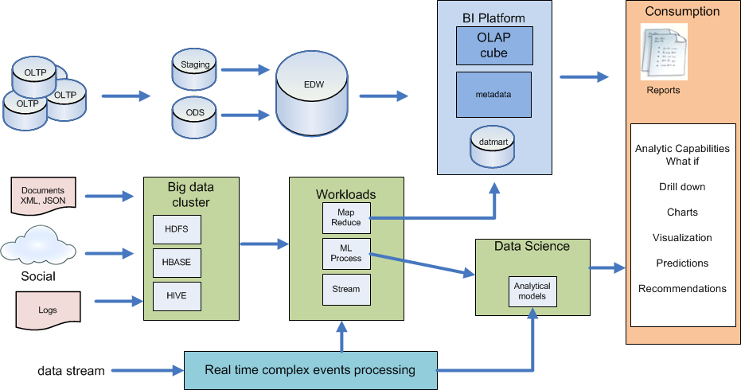
one extended architecture
Notes:
Concepts that come with hadoop that we didn’t have before
One example of an extended architecture – enhance the current with new workloads
This is not easy to achieve – as organizations have these workloads in different parts of the organization, with conflicting goals and objectives

Slide 28
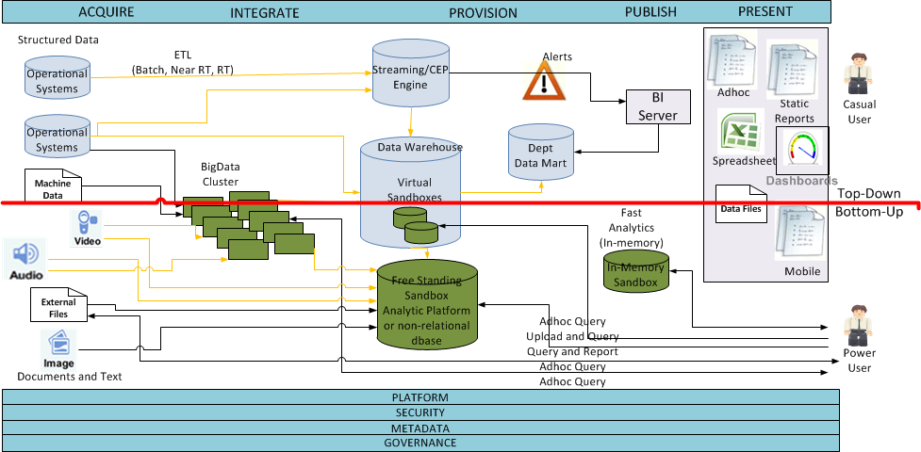
Notes:
Virtual Sandbox – environment close to the data that users can access to do analytical research.
Free standing Sandboxes – a copy of the DW data for trending type of analysis plus other data sources, types,
In-Mem Sandbox – analytic environment that users can use to run complex queries that take too long in regular environment.
Big Data Cluster allows for MPP process where scale out is needed.
All can be done on-prem or in the cloud as services

Slide 29
benefits and new capabilities
ability to process big data
advanced analytics – ML, complex SQL, semantics
data discovery
data archiving
data staging with data archiving
data lakes for POC analytics
real time fraud detection
Notes:
Many different tasks – workloads – components of the traditional data warehosue
Reduce the price of storage

Slide 30
benefits
lower costs
storage is commodity servers or someone else’s cloud
no support fees
shifting investment to people
top notch developers
passionate individuals
millennials
different approach
shorter timeframes
open source mentality of exposing and sharing

Slide 31
components most adopted
Analytics environments and structures,
in memory analytics
managing non relational data
real time operations
SQL based analytic appliances
shared metadata repositories
Notes:
big data technology has been to incorporate all the above mentioned data management and analytics concepts and provide a cheap option for Total Cost of Ownership (TCO).
Open source big data technologies – Hadoop and Cassandra’s NOSQL a new wave of data management has emerged.
Big data technologies provide a concept of utilizing all available data through an integrated system. Big Data can add structured, unstructured and/or semi-structured data captured from transactions, interactions and observations systems to the mix:
Transactions Data: This can be a historical transactions data from core business application systems; structured data at rest and data which is captured but unused
Interactions Data: Social media data – data from LinkedIn, Twitter, Facebook, etc., and Web content – clickstream, web logs, video, images, etc.
Observations Data: “Internet of Things” – streaming data, and machine generated data – data generated from sensors, GPS, RFID, Mobile, etc. -

Slide 32
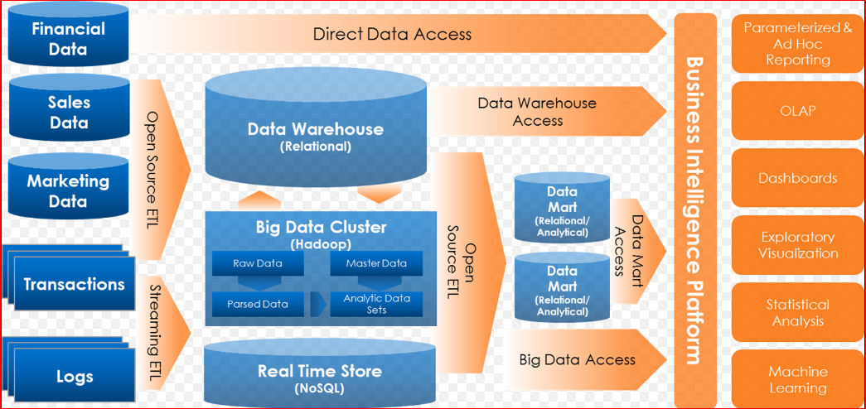
architecture components of the big data data warehouse
Notes:
What happened in 2008?
Hadoop salesforce

Slide 33
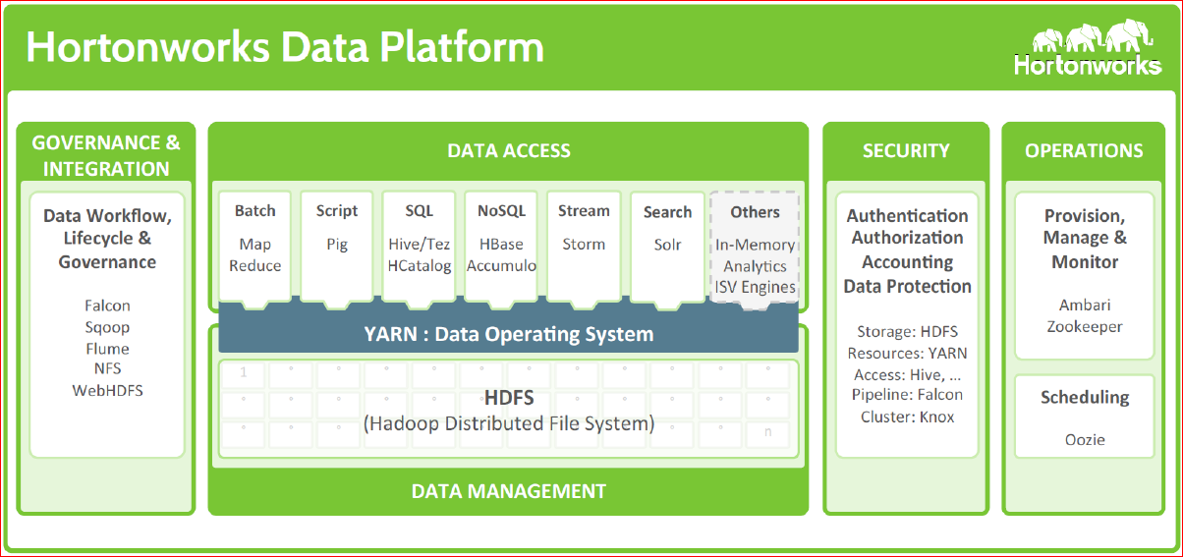
architecture components of the data warehouse
Notes:
Components – an ecosystem of capabilities

Slide 34
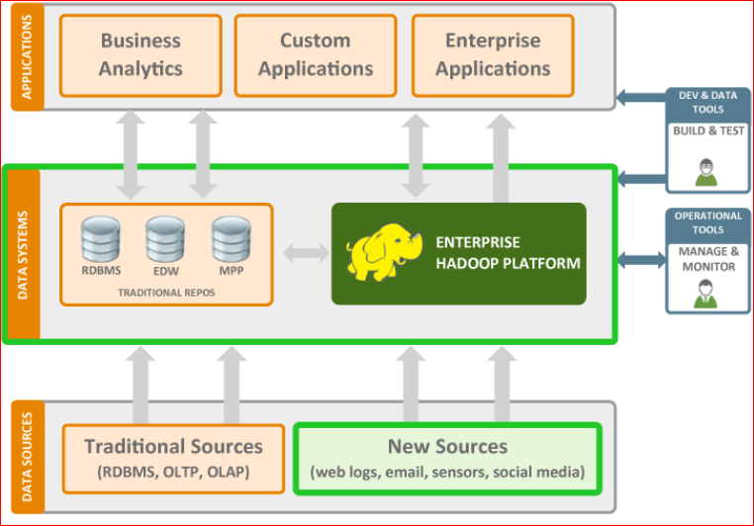
big data data warehouse Hadoop only
Notes:
Component - Hadoop happened as well

Slide 35
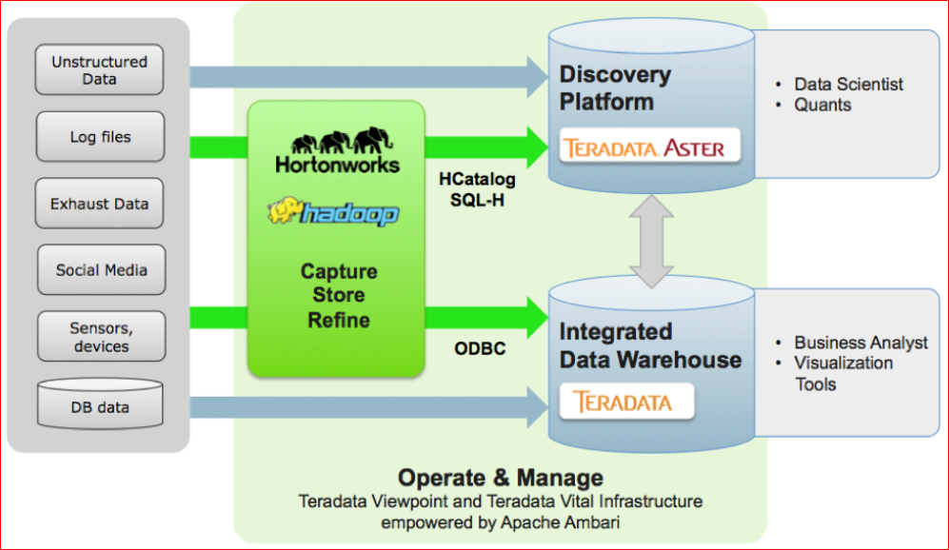
big data data warehouse appliance
Notes:
People components
Jobs are changing
Methods are changing

Slide 36
benefits of the big data data warehouse
short iterations of development due to agility
less governed
developer skills are versatile
schema on read
app centric
more data
low risk if it fails
long time for projects due to complexity
more governed
reliability
specialized skills
schema on write
data centric
better data
high risk if it fails ( expensive)
Notes:
People components
Jobs are changing
Methods are changing

Slide 37
capabilities
predictive and prescriptive analytics
real time fraud detection
genomics – only possible due to super computers and big data
3d virtualization
in mem processing
GPU’s new generation computing chips from gaming industry (1000 CPU’s on one chip, small computations, but many)
new vocabulary – ingestion, provenance,
Notes:
5th normal form of data modeling – a thing relates to a thing just became multi dimensional
Everything to everything
Some of these technologies were only possible after we experienced with the other technologies that happened before

Slide 38
Summary of changes
New types of data
Non relational
Stream
New structures
Analytic sandbox
New technology
Hadoop
MongoDB
New skills / Additional skills
Data miner
Data scientist
New ways of getting things done
In mem computing
Columnar storage
Pair values repository
Integration practices beyond
Unstructured
Python, R, NoSQL
Complex events
Logs, text, Pictures, e-mail,
Big Data processing clusters
Analytic Models
NoSQL Modeler
data movement
In cloud processing and integration
Mobile channels
Notes:
New use cases
Embedded analytics real time fraud detection
Realtime loan risk assessment
Optimize online promotions based on geo location
Real time analysis engine
traffic flow optimization
Risk analysis
Correlation of unrelated data – weather effects on product sale
Web event analysis

Slide 39
Specific Technologies
Technology | Description | Vendor/Product
In Memory Databases | Systems that load data in memory for complex processing | SAP HANA, QlikView, Membase
Distributed File based systems | Distributed file systems designed for storing, indexing, manipulating and querying large volumes of unstructured data | Hadoop (Apache, Cloudera, MapR, HortonWorks) Apache Hive, Apache Pig
Analytical Services | Analytical platforms delivered as a hosted or public cloud based service | 1010data, Kognito
NoSQL | Non relational databases optimized for querying unstructured data as well as structured data | MarkLogic, MongoDB, Splunk, Attivio, Endeca, Apache Cassandra, Apache Hbase
CEP/streaming engines | Ingest, filter, calculate and corelate large volumes of discrete events and apply rules that trigger alerts when conditions are met | IBM, Tibco, Streambase, Vitria, informatica, Opalma, Sybase
MPP analytical databases | Row-based databases designed to scale out on a cluster of commodity servers and run complex queries in parallel against large volumes of data | Teradata Active DW, Kognition, Dataupia Satori Server, Greenplum (EMC)
Advanced Analytics languages | Programming languages used to model statistical analytics patterns and use data to process models | R, Python, Perl, Ruby, C#
Virtualization middleware | Software that allows for data virtualization | Denodo, MarkLogic

Slide 40
Graph technology

Slide 41
Critical Analytic Capabilities
Information portal
Reporting
Dashboards
MSOffice Integration
Mobile BI
Embedded Analytics
Analytics Workbench
Data Discovery
Adhoc reporting and Query
Geospacial/Location intelligence
OLAP
Business user modeling ( What if)
Collaboration
Data manipulation
Data Science Laboratory
Advanced Data access
BigData Sources
Advanced Descriptive Analytics
Predictive Analytics
Forecasting
Optimization
Simulation
Other Advanced Analytics
NoSQL stores
Notes:
BI is changing from reporting to the data science laboratory

Slide 42
top ten
1. . new technology
hadoop
in memory processing
onyara type integration
basho
2. new types of workloads
map reduce
machine learning
predictive modeling
geo mapping
data science in general
streaming social data
3. new databases
Mongodb
Hive
counchdb
cassandra
ryak
4. springboard for new software
onyara
5. new methodology
stream processing
data lake
big data orchestration
Kegllar
6. new skills
hadoop developer
data scientist
big data architect
7. new companies
basho
hortonworks
cloudera
Domo
thoughtSpot
many-many more
8. Adaptive sourcing - open source
9. BI becomes search
10. Truly distributed processing

Slide 43
architecture benefits of the big data data warehouse
More choices for types of data platforms
data warehouse appliances, columnar databases, and Hadoop.
information exploration and discovery
based on technologies for SQL, NoSQL, mining, statistics, and natural language processing
common types of analytic applications benefit from a multi-platform DW
a diverse platform portfolio can handle a diverse range of data types
handling data in real time usually requires an additional purpose-built system.
adding low-cost platforms to a DW environment makes big data more affordable
Hadoop and NoSQL platforms give more favorable economics to big data management practices, such as data staging for data warehousing and data archiving
extended DW environments use new brands of analytic databases, i.e. appliances and columnar RDBMSs and the analytic databases are more affordable for most configurations.
Notes:
People components
Jobs are changing
Methods are changing

Slide 44
industry use cases
risk management
fraud detection and management
intelligent customer upsell in retail banking
wealth management
(combination of new sources of data to make investment decisions)
sensor data
transportation data
medical industry
data warehouse optimization

Slide 45
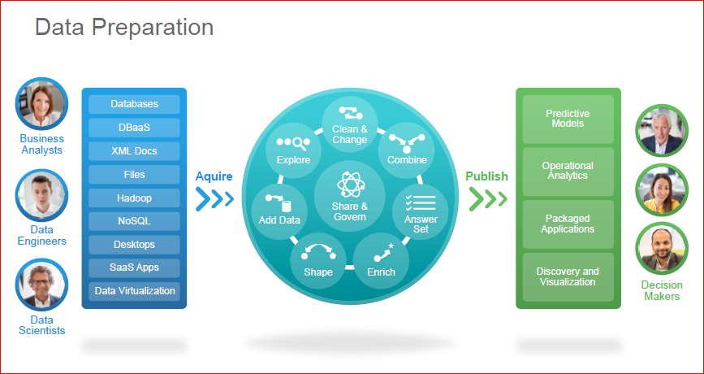
What is new with the data?
Things we work with
What we do with the things
How we use the things

Slide 46
tools
metadata and governance
analytic applications
self service data products
tools merging into platforms
cloud solutions
Notes:
Metadata and data governance: There are emerging approaches to detecting metadata from user activities or through user collaboration (for example, Cloudera recently acquired Xplain.io for this purpose). Also, new data governance tools are progressing (not data governance itself — it is a discipline that requires active involvement of your data governance organization). Examples include Apache Atlas, Cloudera Navigator and Waterline Data Science.
Analytics applications: YARN and Spark give many new and relatively easy means for developing analytical applications on Hadoop. On the one hand, you will be able to build your own applications. On the other hand, there will be commercial applications that solve particular problems. Perhaps one of these applications will more easily solve a problem that you are currently solving with complex architecture.
Proliferating data products: What was possible only for data scientists would be available to the average BI audience through self-service. Examples of emerging data products include self-service data preparation (Paxata and Trifacta) and advanced analytics (Ayasdi, BeyondCore and Sisense).
Real-time solutions: These include streaming and in-memory processing. Lambda architecture and Kappa architecture are in fashion for low-latency analytics. Yet, these solutions are a sign of the absence of more comprehensive solutions. Apache Spark is a promising technology for the Hadoop community in terms of low-latency solutions. Most Hadoop ecosystem vendors, including analytics providers, are working on supporting Spark to take advantage of its in-memory capabilities.
Tools merging into platforms: Many niche tools for Hadoop evolve by adding new capabilities, and they eventually grow into platform solutions, albeit often limited. Hadoop itself is now a platform for the Hadoop ecosystem. On the other hand, megavendors expand their platforms to Hadoop; Teradata Unified Data Architecture is proof.
Cloud solutions for Hadoop: New and improved cloud solutions became available in 2015. The list includes all Hadoop distributions' availability in the cloud; pure-play Hadoop in the cloud — Google, Qubole and Altiscale; Apache Spark, which is enthusiastically embraced in search of fast and effective analysis of Hadoop data, via the Databricks Cloud; and a variety of cloud analytics solutions like Amazon Kinesis or Microsoft Machine Learning Studio (ML Studio). Additionally, new data warehouse solutions in the cloud — Amazon Redshift and Snowflake, as well as traditional EDW solutions in the cloud — compete with Hadoop for certain use cases and provide affordable pricing.

Slide 47
changes
open source, adaptive sourcing
truly distributed processing
one man show – the data scientist
visual interpretation
the same is the new
Notes:
Our treshhold and sensitivity to open source will change
The way we approach things – much faster
How google works – the problem is posted on the board on Friday am, by Monday am it is solved
One person understands the vertical of a solution + how to approach data
The same problem - how we process data to tell us something we cannot see, don’t know about our business
the same approach – we ingest the data, we process the data, we use it
the same people – IT people that guard the data, transform it, use it
What is new – are the times, the technology

