Slide 1
Visualizing Effectively
Manjeet Rege, Ph.D.
Associate Professor
Graduate Programs in Software
University of St. Thomas
rege@stthomas.edu

Slide 3
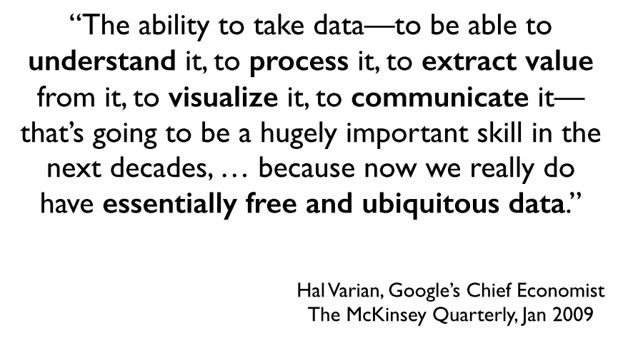

Slide 4
Limits of Cognition

Slide 7
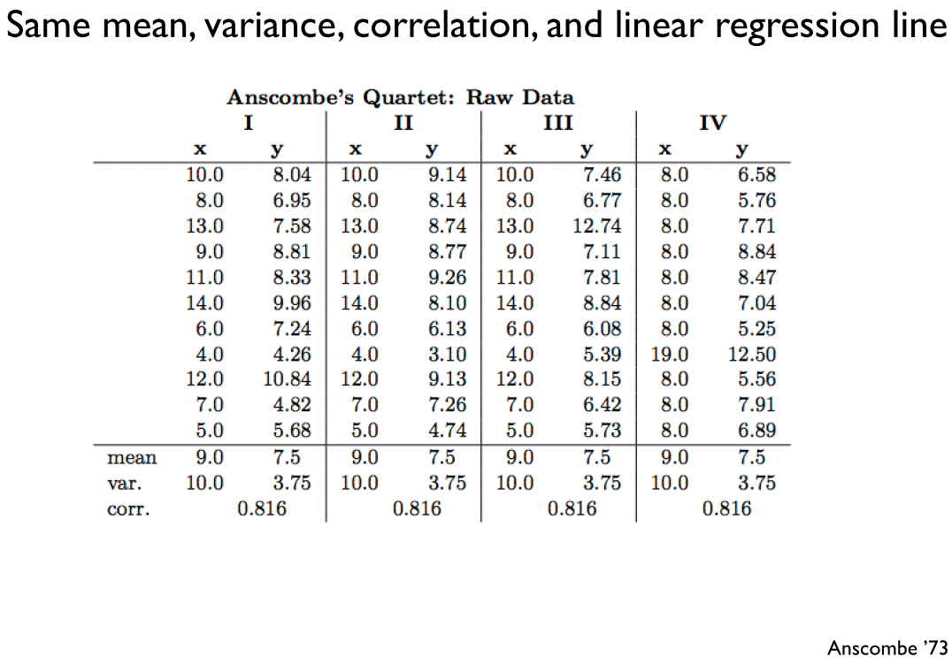
Anscombe’s Quartet

Slide 8
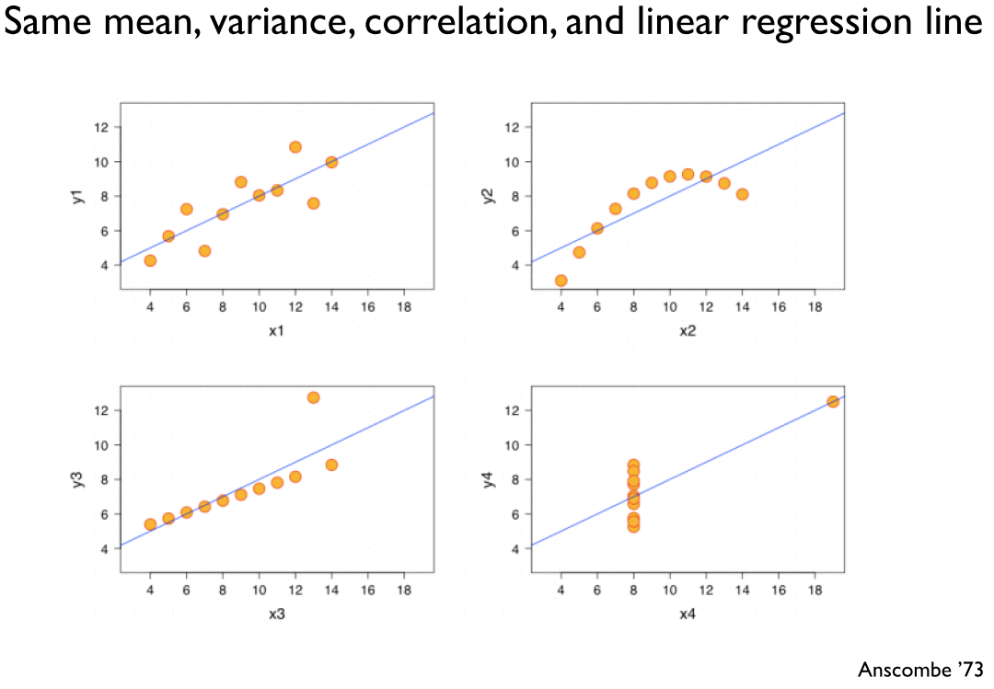
Anscombe’s Quartet

Slide 9
Why visualize?
Data visualization is not a personal preference, to be done “just in case some people are more visual.” It is a necessity!
The previous slide is a classic example of how some insights can only be found through visualization.
The first step in understanding your data should always be to examine it visually. Visualization can play a critical role in helping you figure out what the interesting questions are.
Picture superiority effect: pictures are retained at much higher rates than words.

Slide 10
Effective Visualizations
Have Graphical Integrity
Keep it Simple
Use the right design
Appropriate Color
Tell a story with data

Slide 11
Effective Visualization – Graphical Integrity
Missing Scales
Distortions
Lie Factor

Slide 13
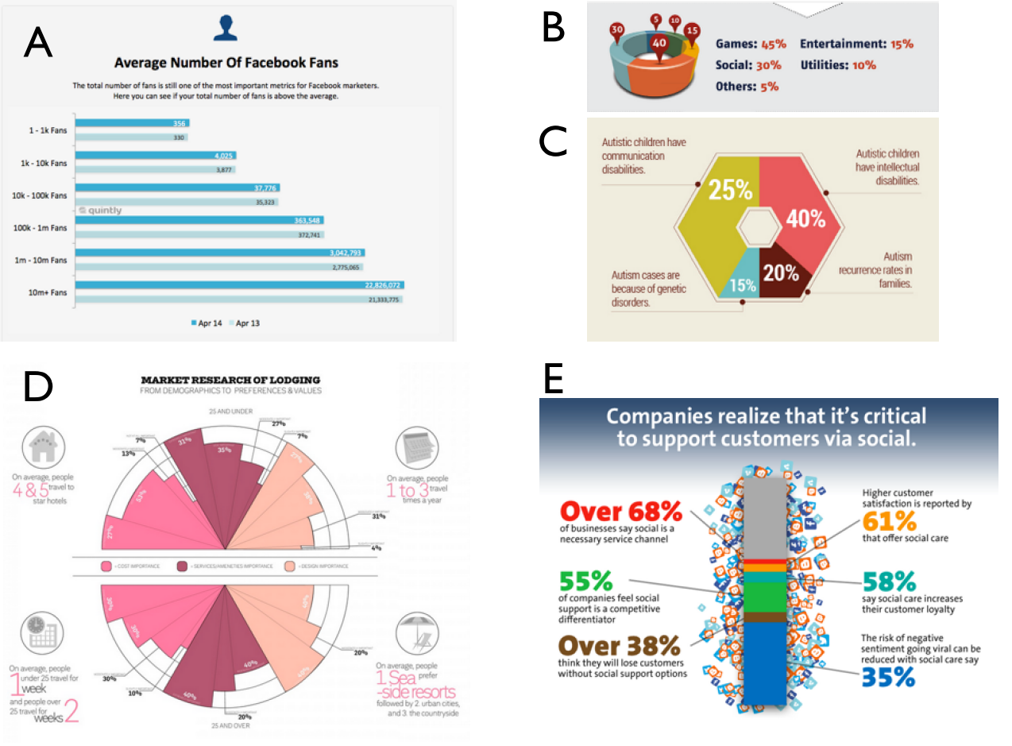

Slide 14
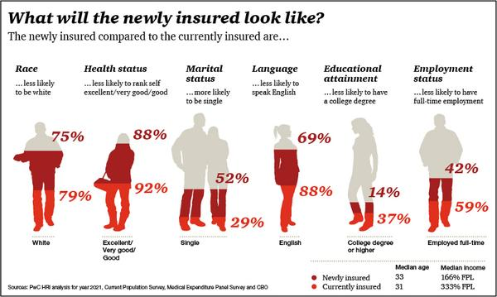
Effective Visualization ?
Washington Post, 2012

Slide 15
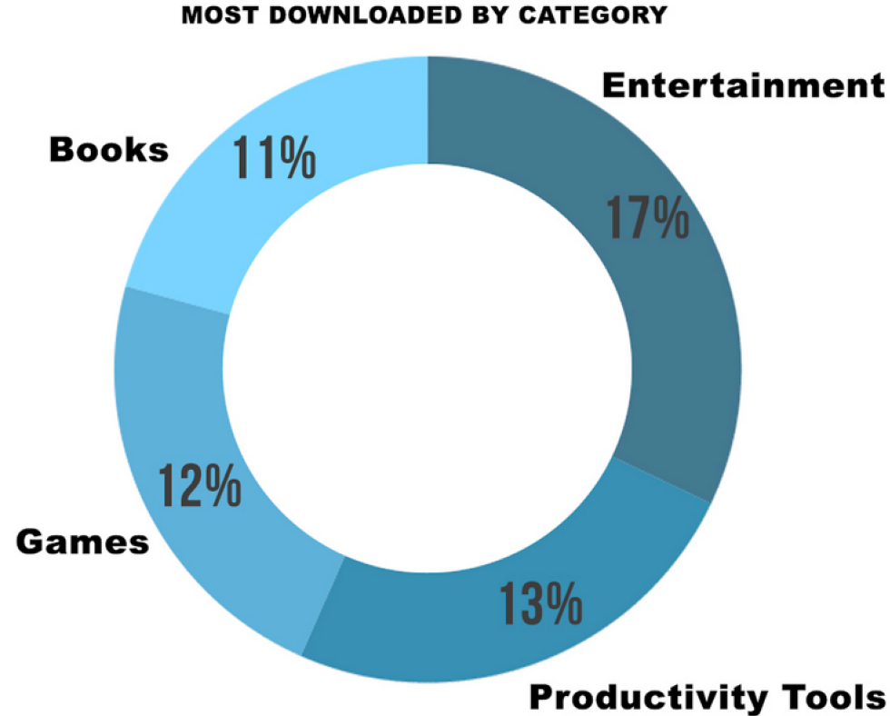
Effective Visualization – Graphical Integrity

Slide 17
Wikipedia.org

Slide 18
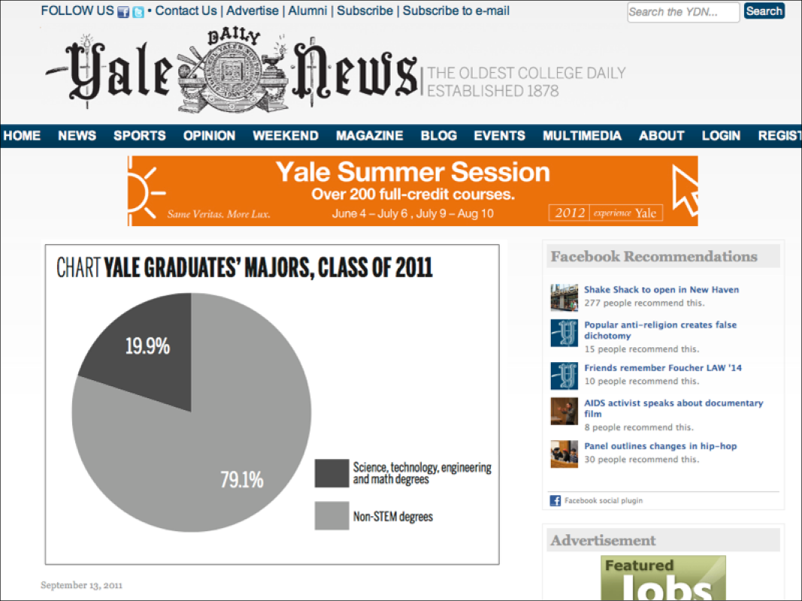

Slide 20
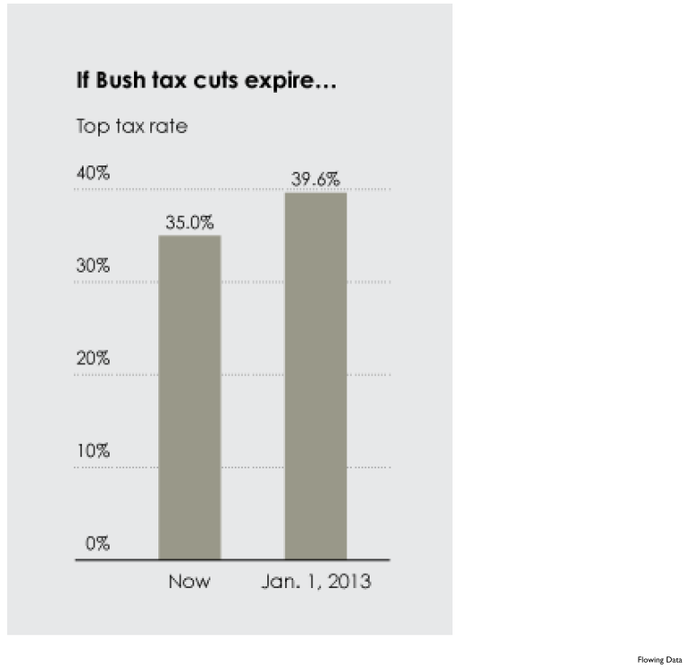

Slide 22
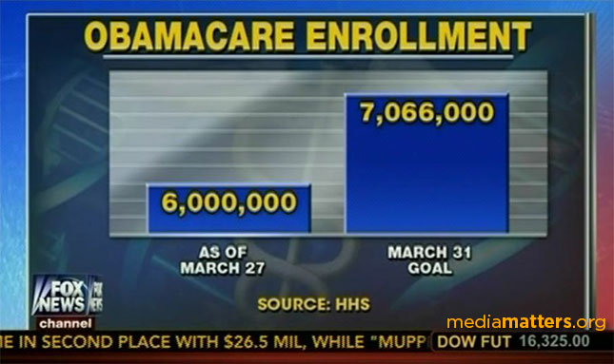
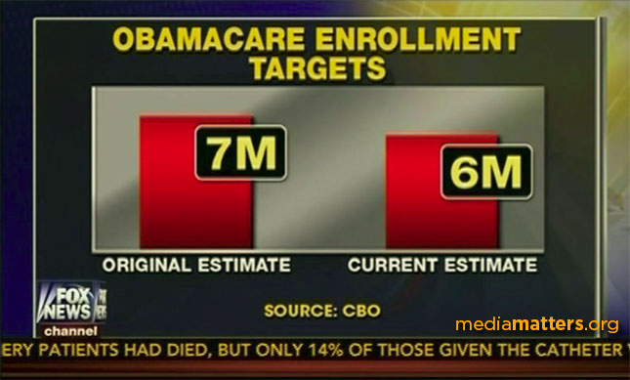
vs.
vs.
http://mediamatters.org/blog/2014/03/31/dishonest-fox-charts-obamacare-enrollment-editi/198679

Slide 24
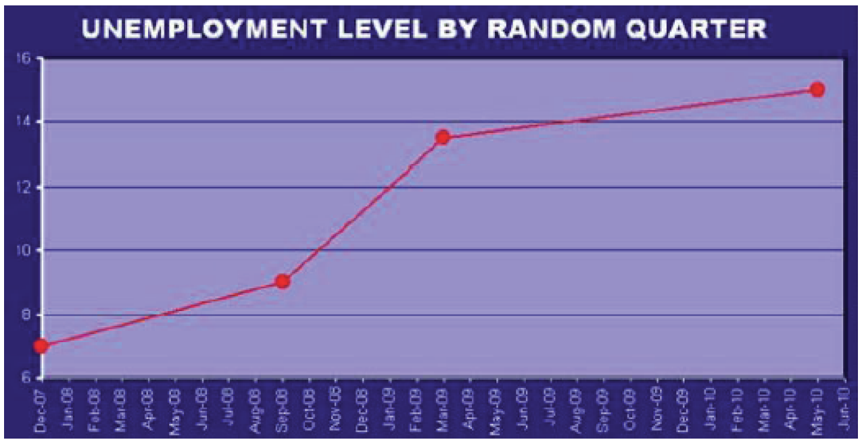

Slide 26
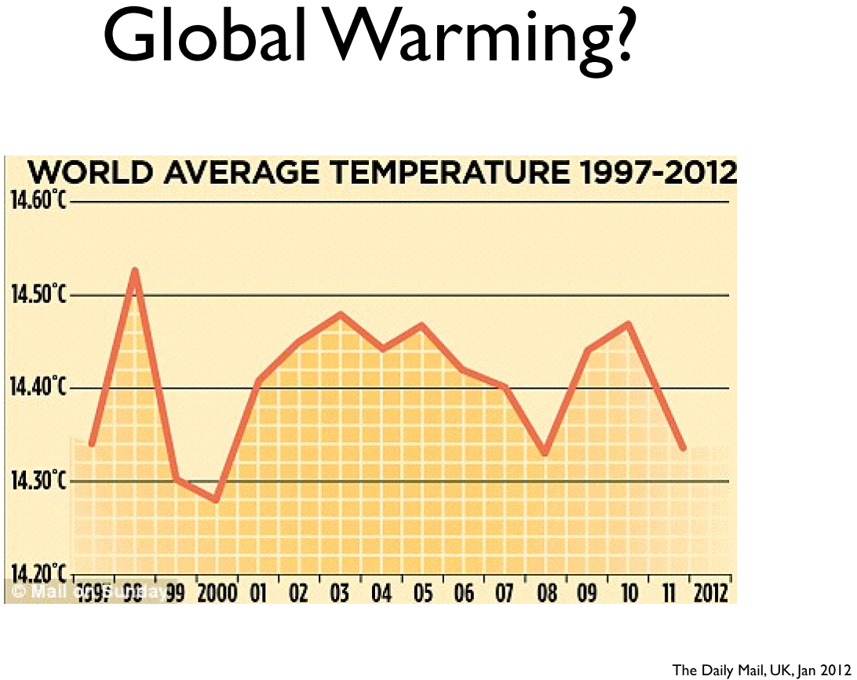

Slide 28
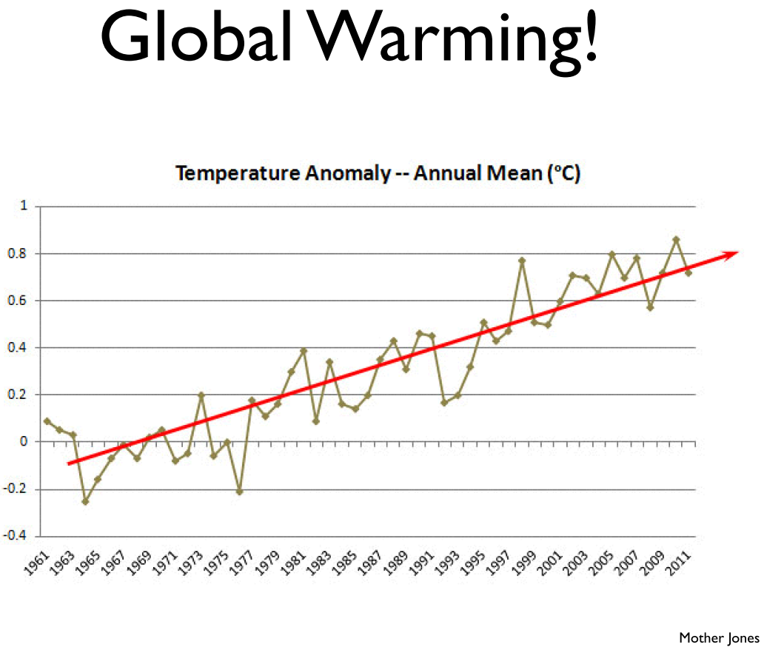

Slide 29
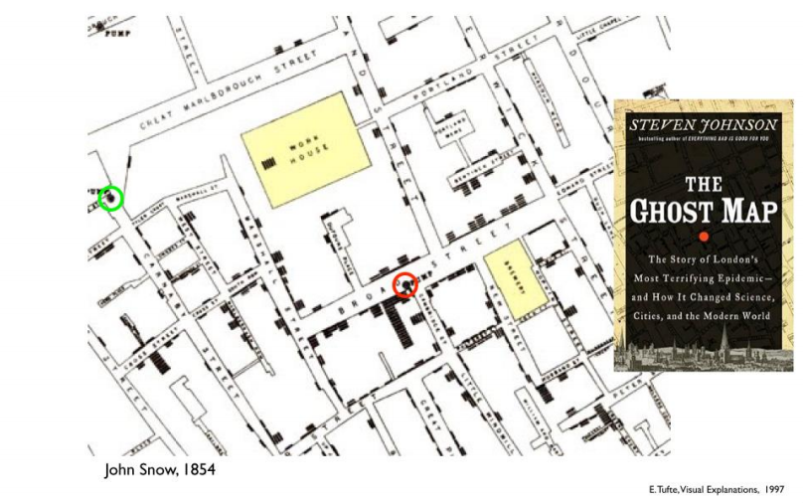
Cholera outbreak in London

Slide 30
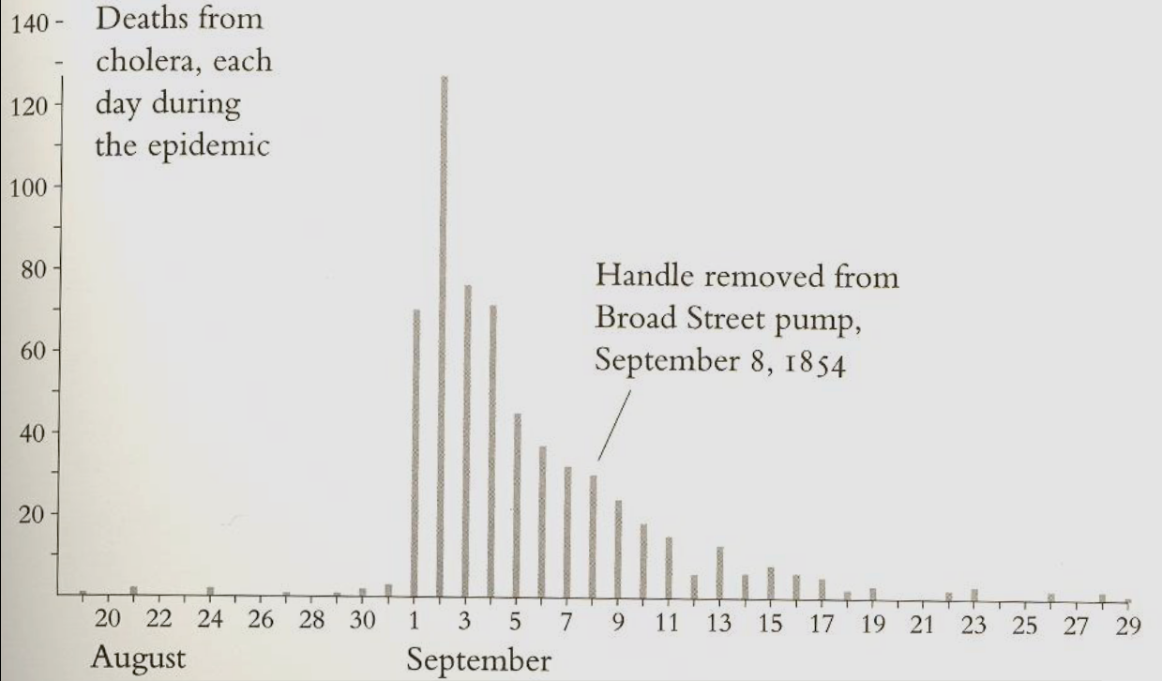
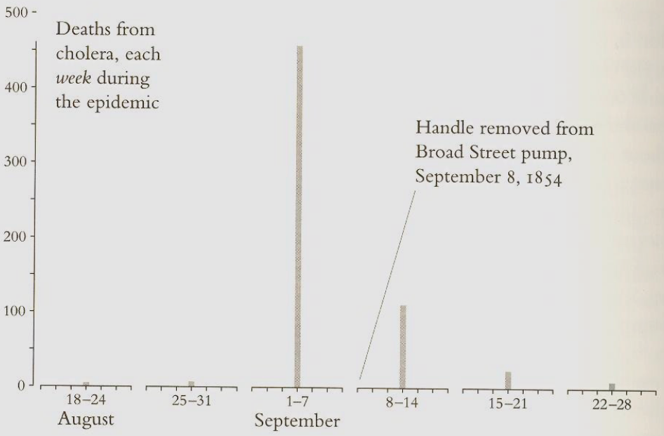
Effects of Binning

Slide 31
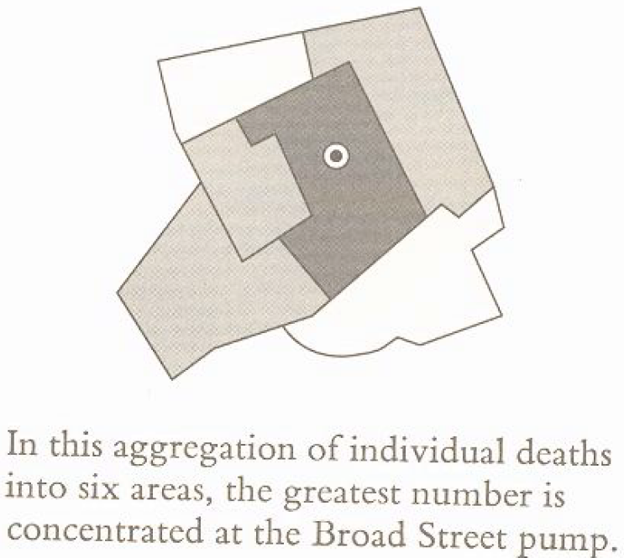
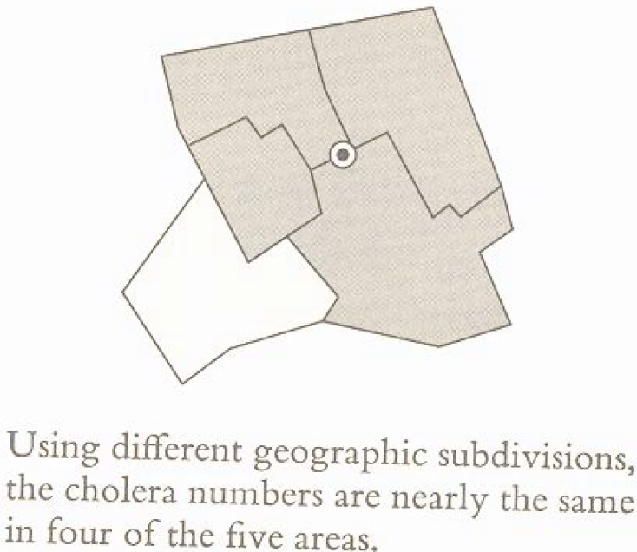
Effects of Binning in Spatial Dimensions
Mark Monmonier, How to Lie with Maps (Chicago, 1991), pp 142-143.

Slide 36
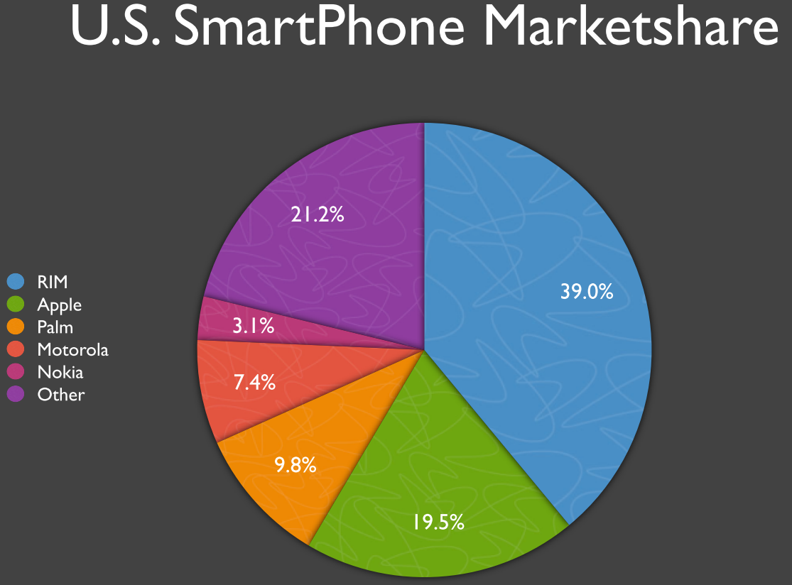

Slide 37
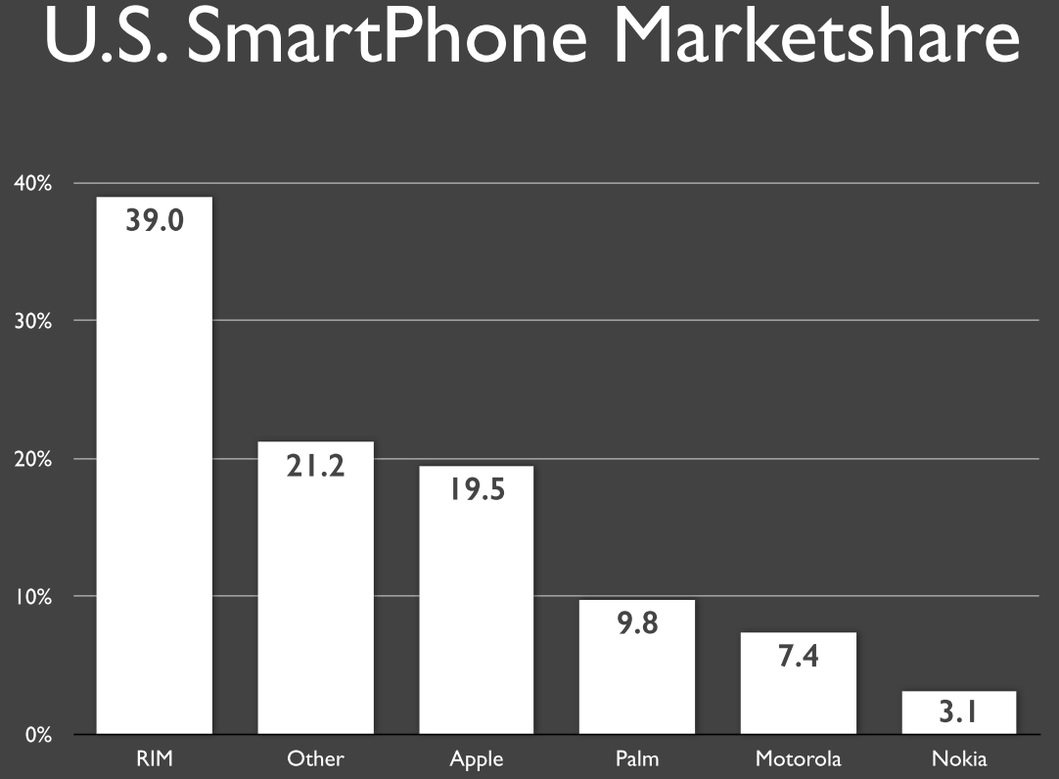

Slide 38
Effective Visualizations
Have Graphical Integrity
Keep it simple
Use the right design
Appropriate Color
Tell a story with data

Slide 48
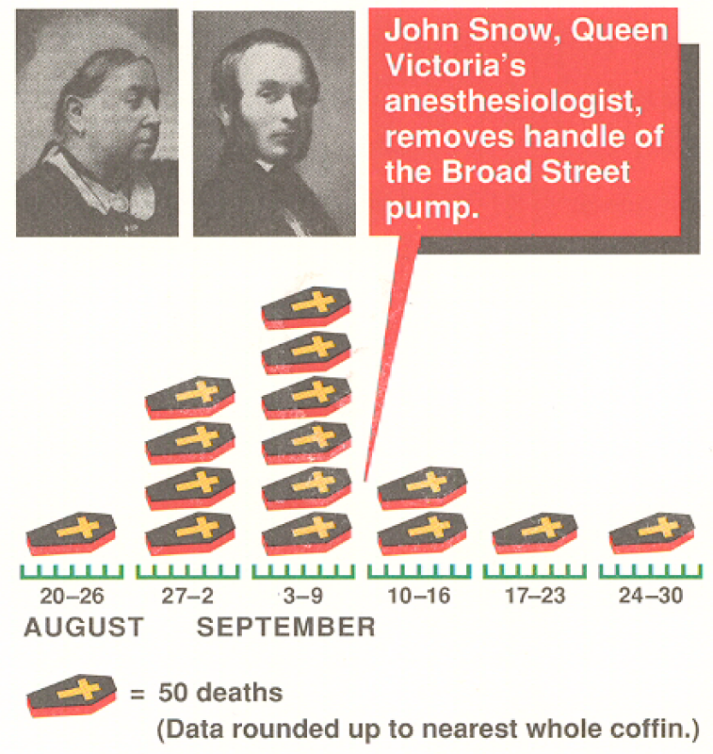
Avoid Chartjunk
USA Today’s version of the 1854 Cholera outbreak

Slide 49
Effective Visualizations
Have Graphical Integrity
Keep it simple
Use the right design
Appropriate Color
Tell a story with data

Slide 53
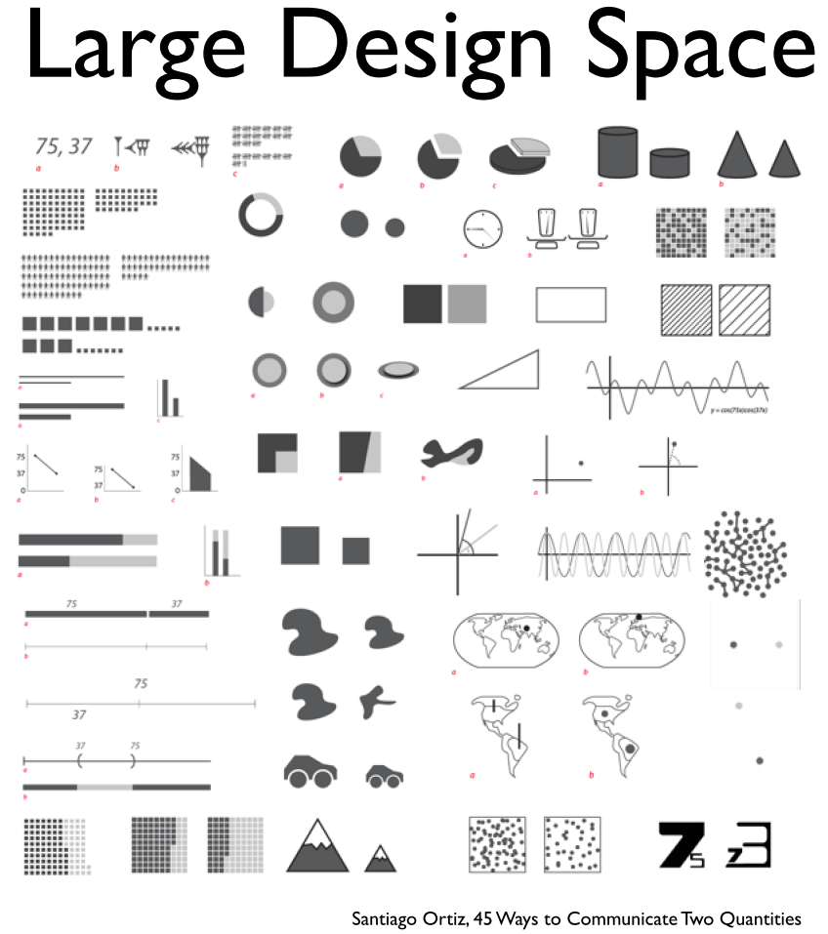

Slide 55
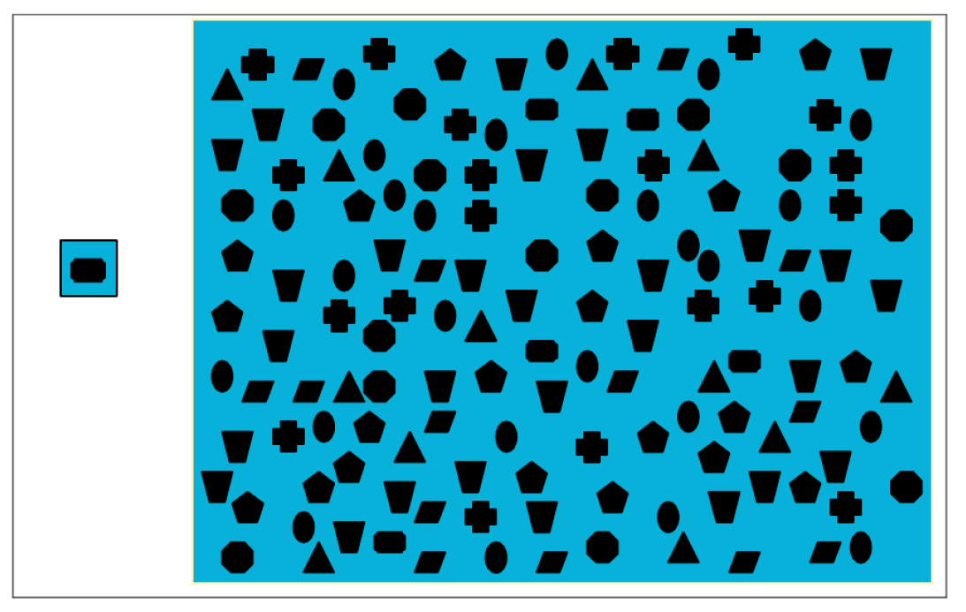
Select

Slide 56
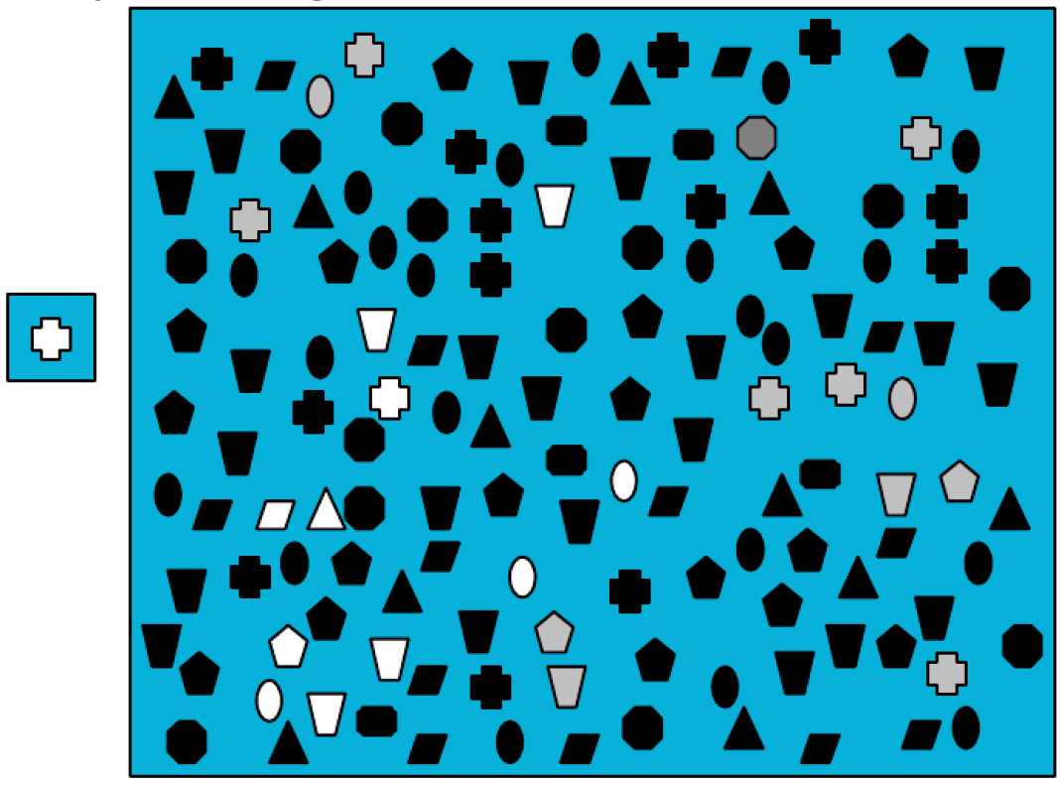
Select

Slide 57
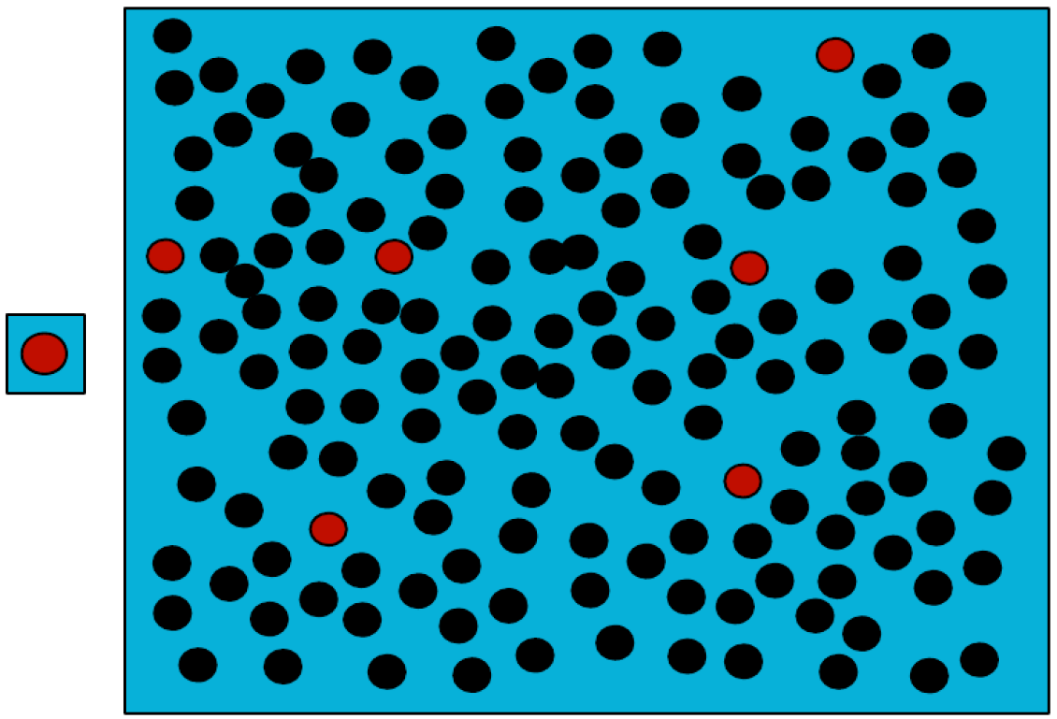
Select

Slide 59
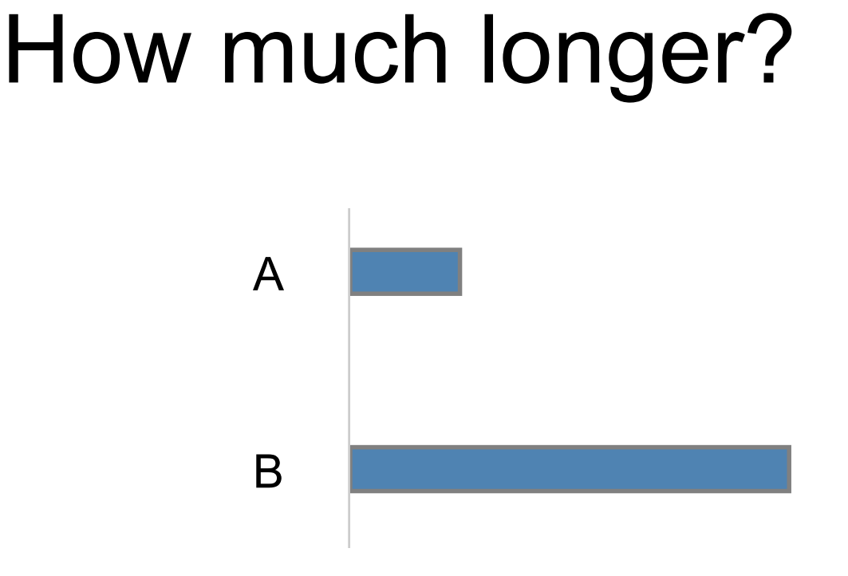

Slide 60
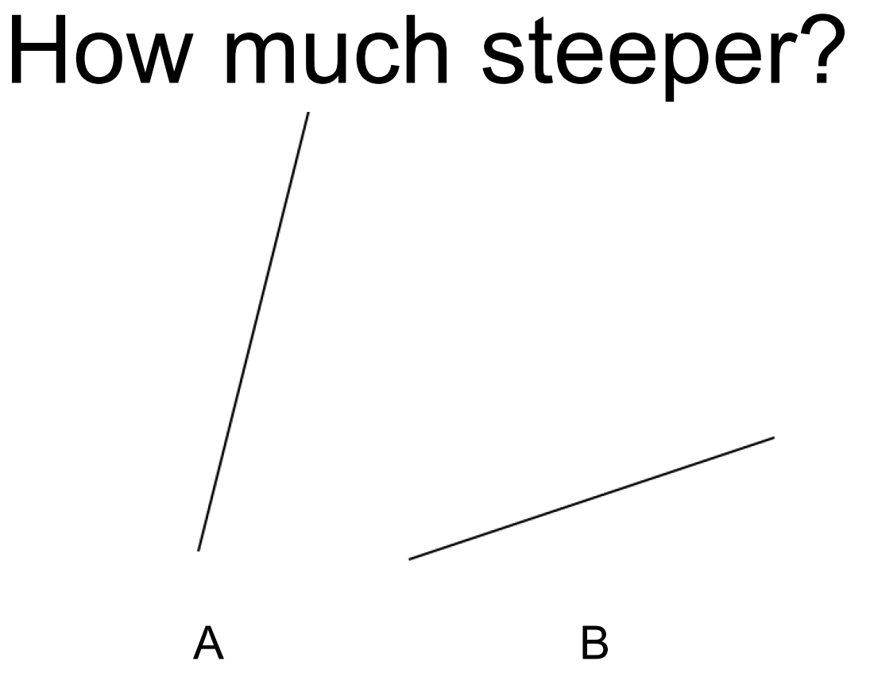

Slide 61
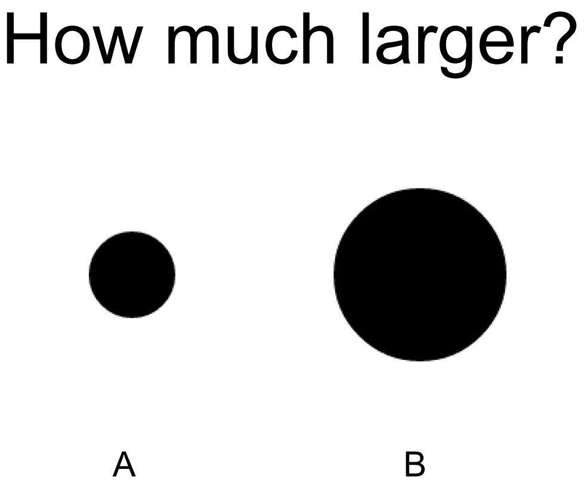

Slide 62
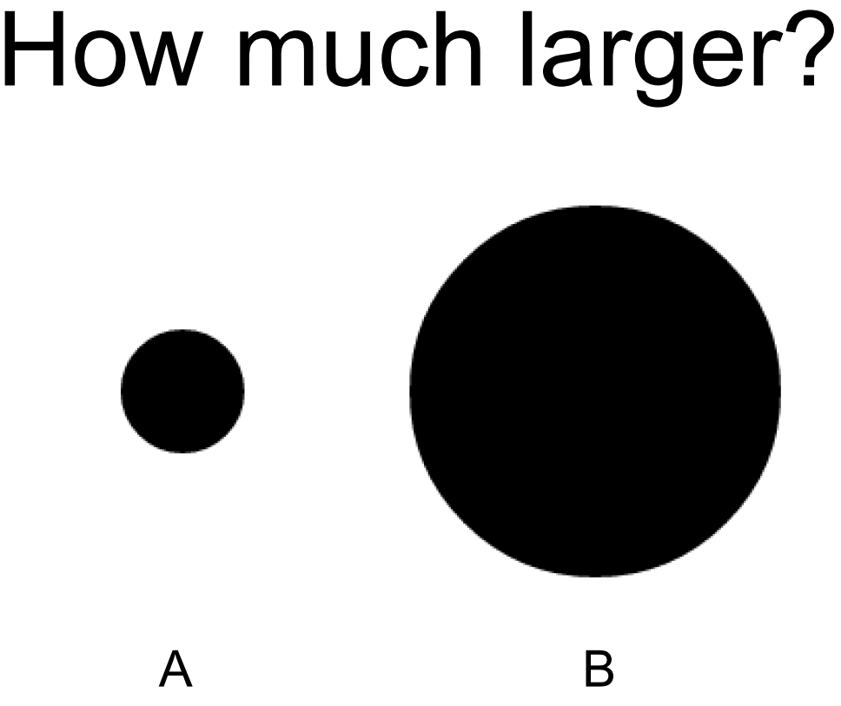

Slide 64
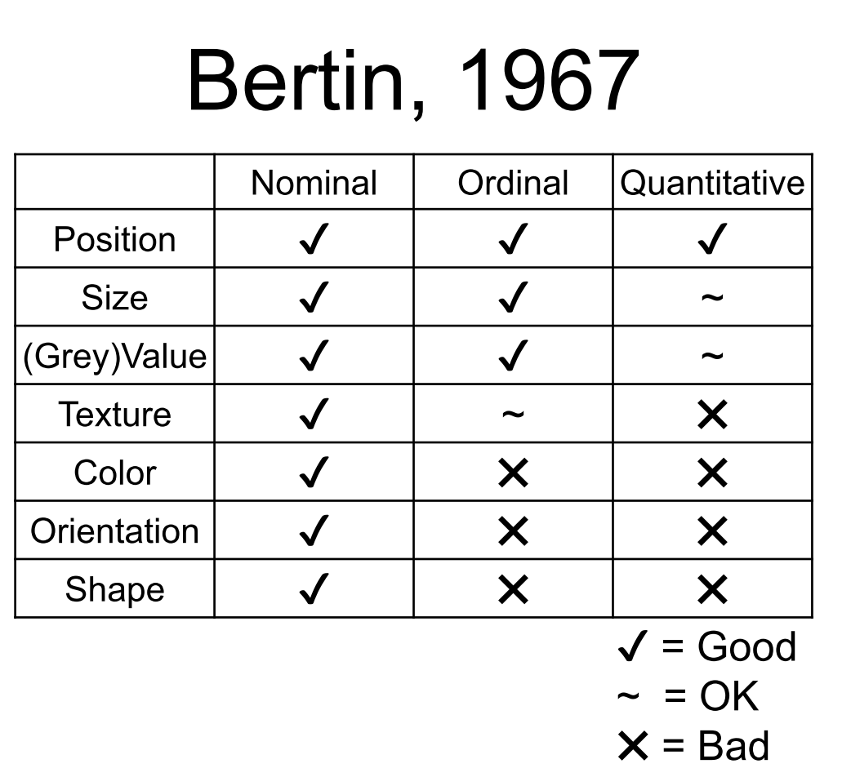

Slide 65
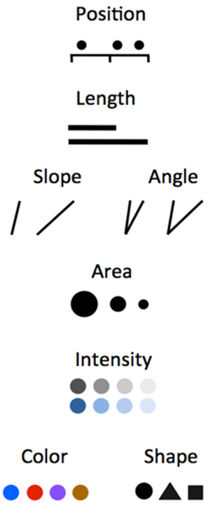
Most Efficient
Quantitative
Ordinal
Nominal
Least Efficient

Slide 68
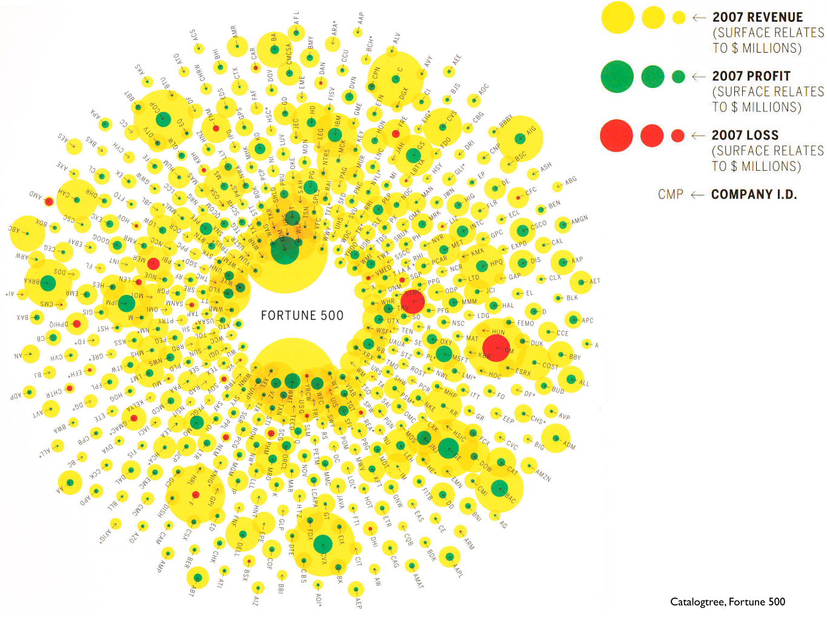

Slide 69
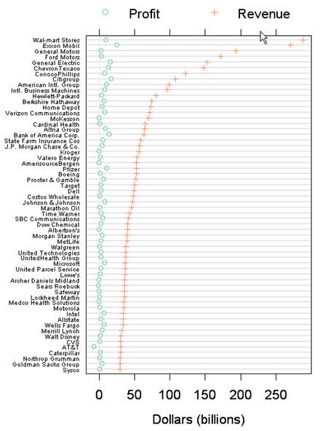

Slide 70
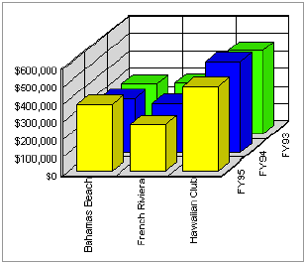
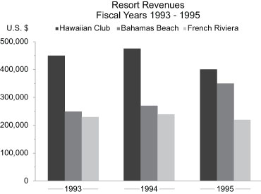
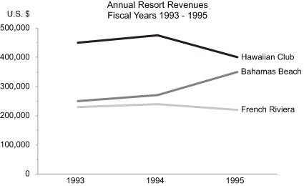
Stephen Few

Slide 71
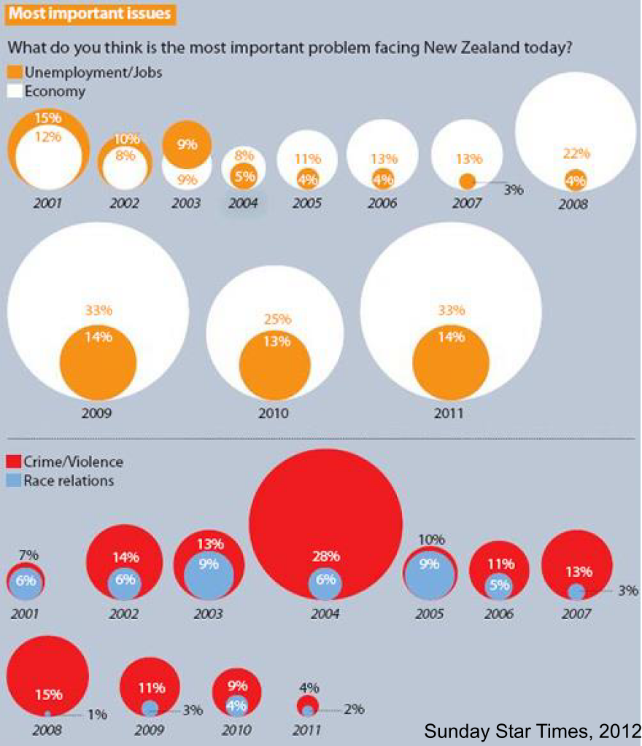
Effective Visualization ?

Slide 72
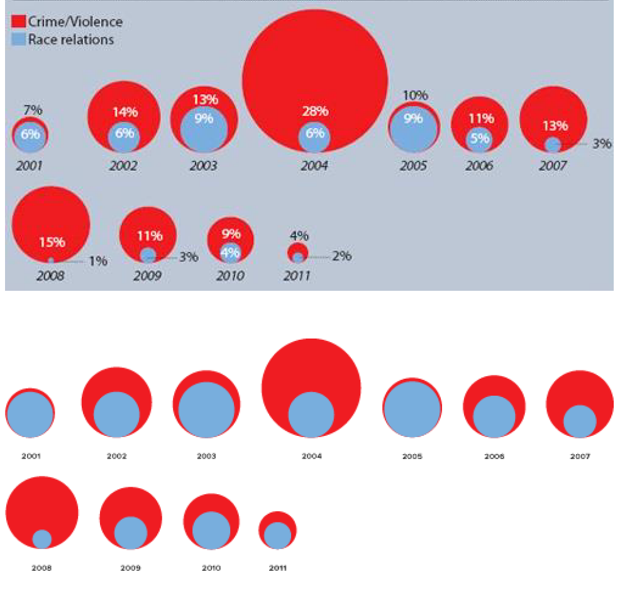

Slide 73
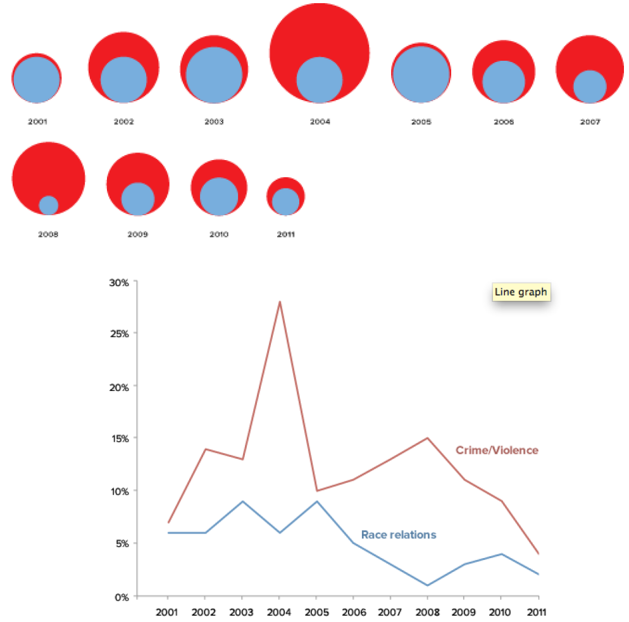

Slide 74
Effective Visualizations
Have Graphical Integrity
Keep it simple
Use the right design
Appropriate Color
Tell a story with data

Slide 75
Color
Humans can distinguish 8 colors approximately.

Slide 76
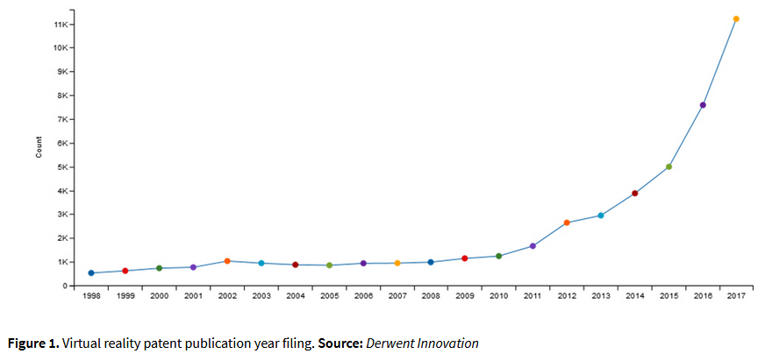
https://clarivate.com/blog/ip-standards/transformational-technology-look-virtual-reality-patent-landscape/

Slide 77
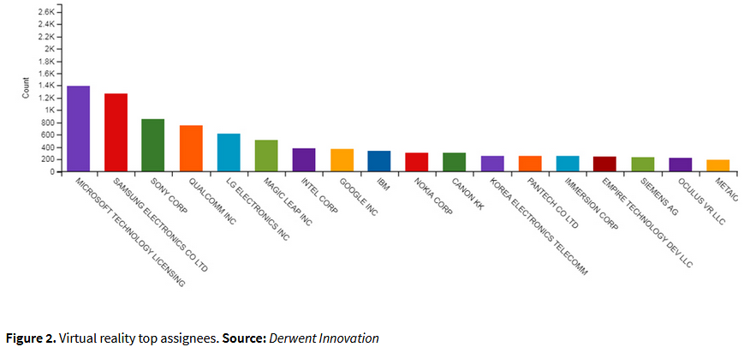
https://clarivate.com/blog/ip-standards/transformational-technology-look-virtual-reality-patent-landscape/

Slide 89
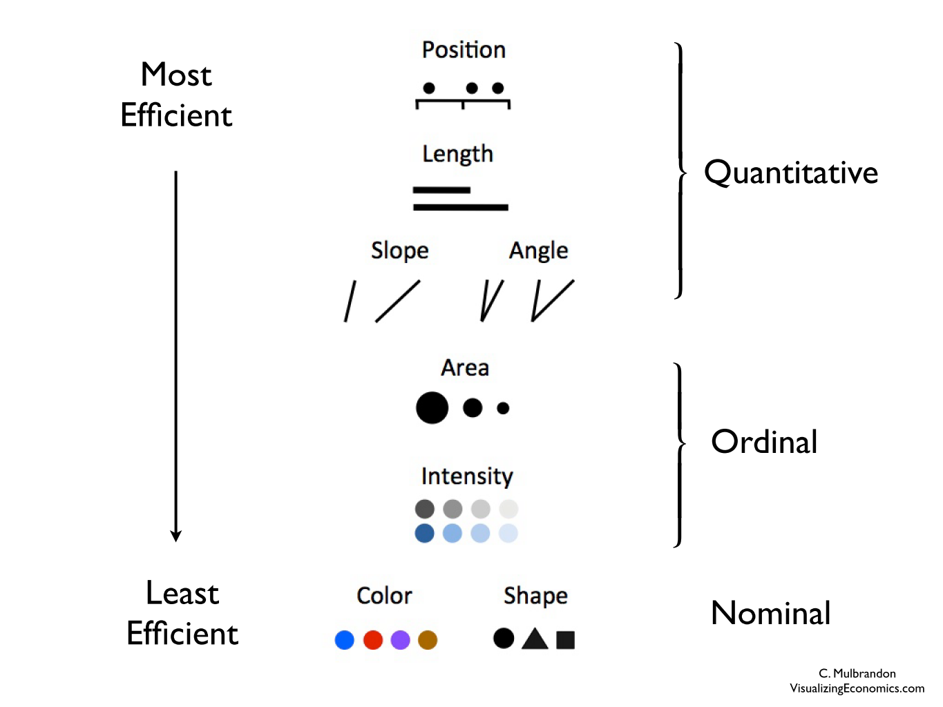

Slide 95
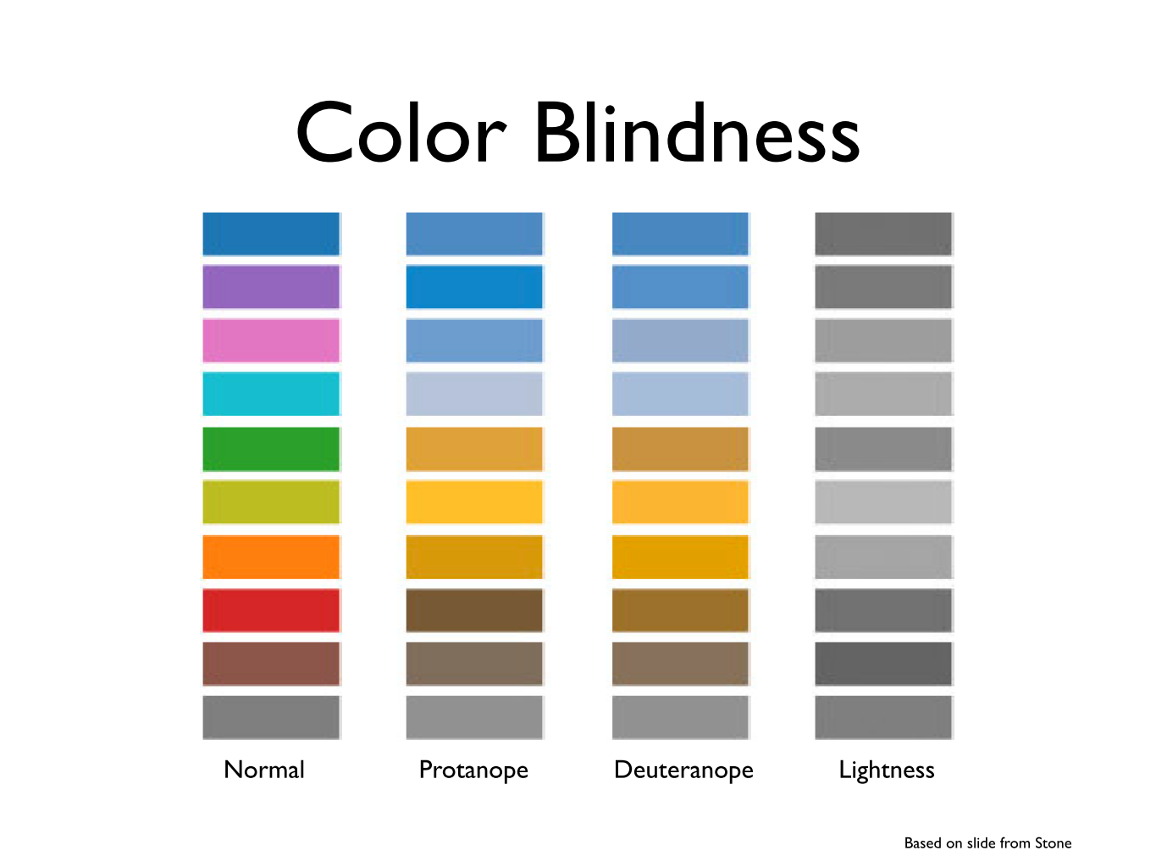

Slide 96
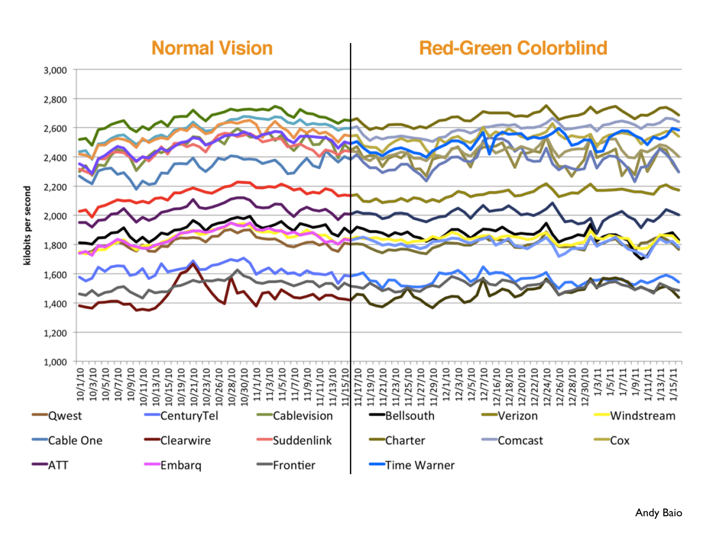

Slide 97
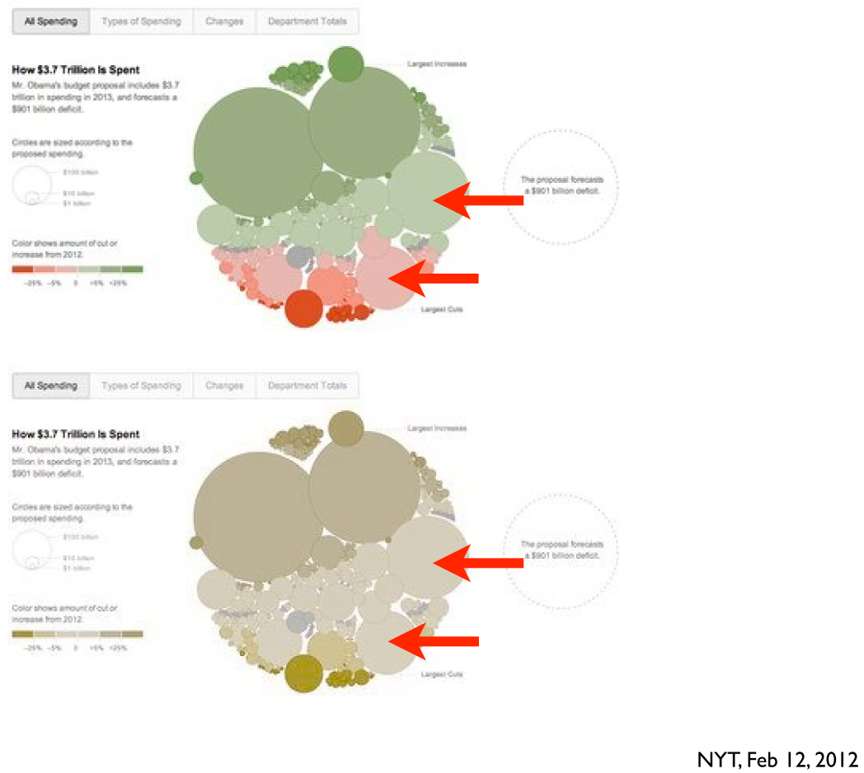

Slide 98
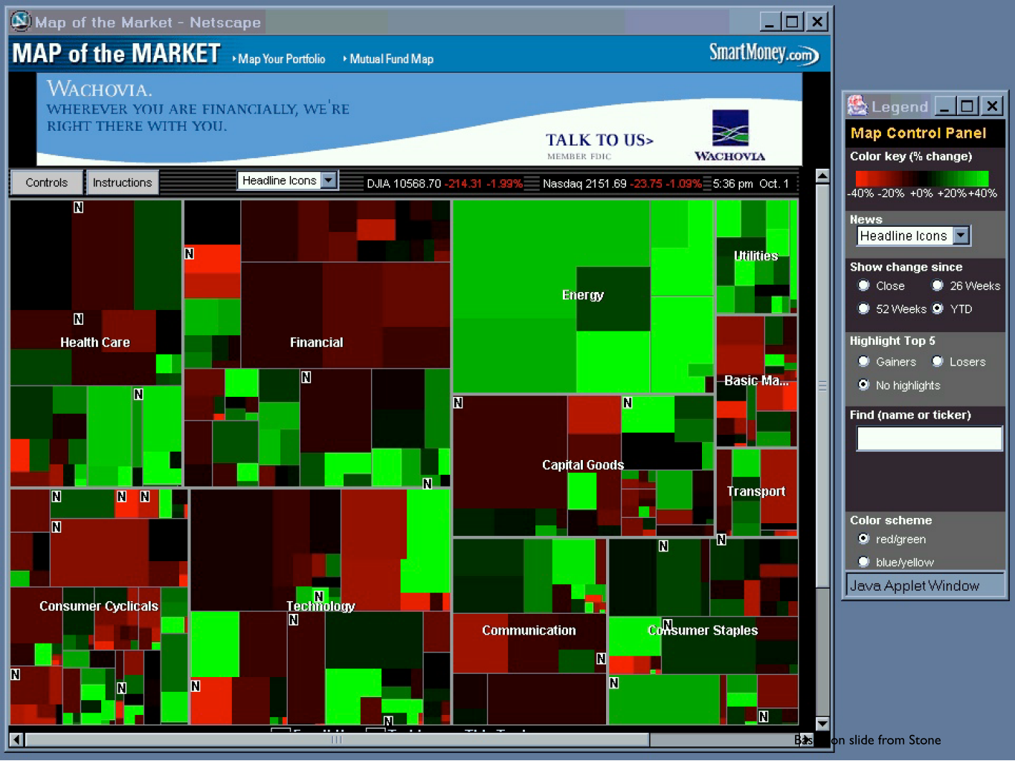

Slide 99
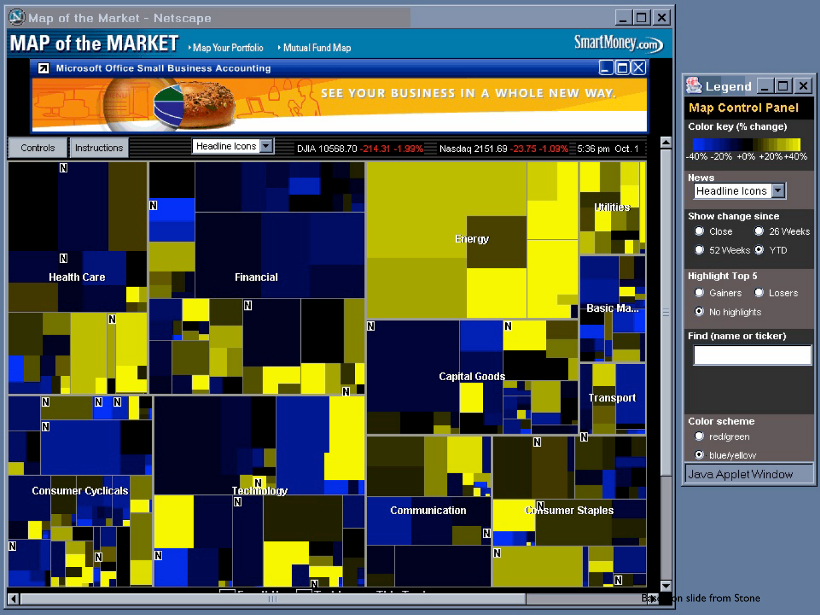

Slide 101
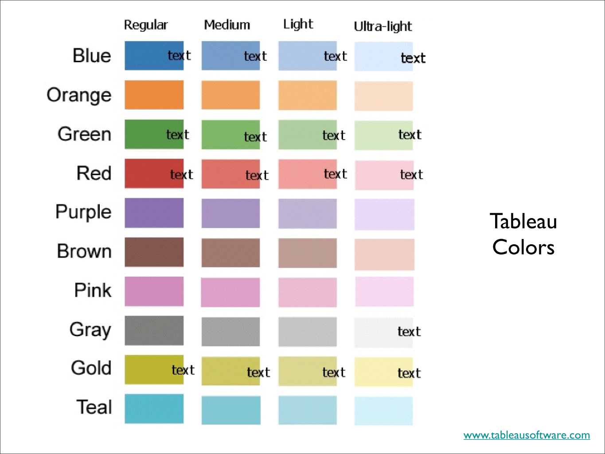

Slide 103
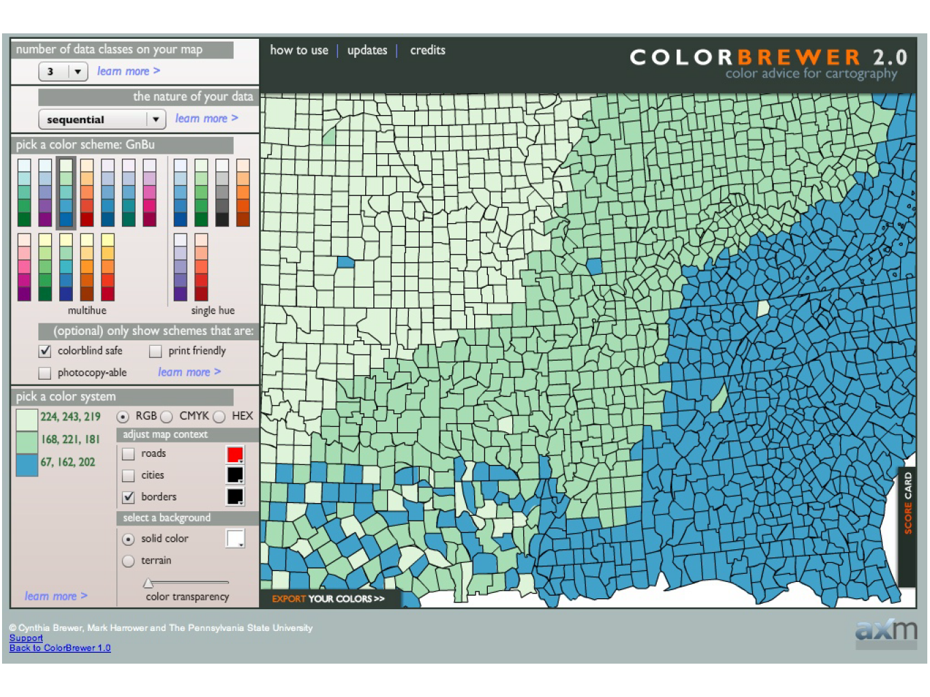

Slide 105
Using Color
FACT: approximately 8% of men worldwide are color blind.
For continuous data, color ramps are effective.
For discrete data, always try to limit colors (under 5 is ideal).
The use of too many colors makes it hard to distinguish, and also requires frequent referencing of the legend.
If you limit yourself to just a few colors, then your audience can actually remember what’s what.

Slide 106
Effective Visualizations
Have Graphical Integrity
Keep it simple
Use the right design
Appropriate Color
Tell a story with data

Slide 108
Data Dashboard Class Project Example

Slide 109
Data Dashboard Class Project Example

Slide 110
Data Dashboard Class Project Example

