Slide 1
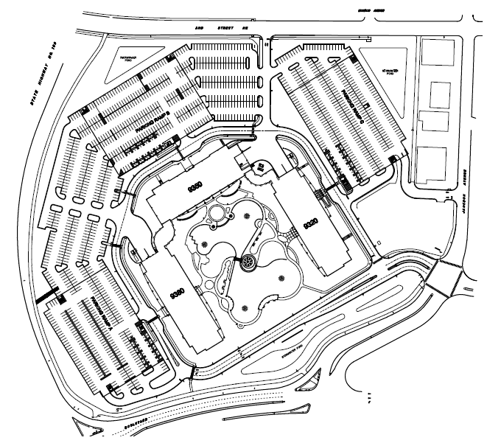
Excelsior Crossings Building 9320
Driving and Parking Instructions
Visitor Parking in Parking Ramp
Building
9350
SOUTH Parking Ramp Entry for Accessibility to :
Visitor Parking
Disabled Parking
Building
9320
Building
9380
Main Campus Entrance at Jackson Street
Excelsior Blvd/Jackson St Intersection

